Slide 1
Crafting Quality Resolutions ALA Council Orientation Edition January 25, 2020
ALA Resolutions Committee
Mike Marlin, Chair
Prof. Oscar Baeza
Marianne S. Hanley
Mary L. Hastler
Jos N. Holman
Sara Kelly Johns
Lynda M. Kellam
Kevin Reynolds
Michael P. Santangelo
Matthew Shaw
Dr. Jennifer E. Steele
William E. Sudduth, III
Patricia Wong (Board Liaison)
Marsha Patrice Burgess (Staff Liaison)

Slide 2
Resolution Form and Content
Resolution on Monetary Library Fines as a Form of Social Inequity
Whereas the first policy objective listed in ALA Policy B.8.10 (Library Services to the Poor) as approved by ALA Council on January 27, 2019, states that the American Library Association shall implement these objectives by “Promoting the removal of barriers to library and information services, particularly fees, and overdue charges”;
Whereas ALA Policy B.4.2 (Free Access to Information) “asserts that the charging of fees and levies for information services, including those services utilizing the latest information technology, is discriminatory in publicly supported institutions providing library and information services”;
Whereas in Economic Barriers to Information Access, An Interpretation of the Library Bill of Rights, ALA states “All library policies and procedures, particularly those involving fines, fees, or other user charges, should be scrutinized for potential barriers to access”; and
Whereas monetary fines ultimately do not serve the core mission of the modern library; now, therefore, be it
Resolved, that the American Library Association (ALA), on behalf of its members
1. adds a statement to the Policy Manual that establishes that “The American Library Association asserts that imposition of monetary library fines creates a barrier to the provision of library and information services.”;
2. urges libraries to scrutinize their practices of imposing fines on library patrons and actively move towards eliminating them; and
3. urges governing bodies of libraries to strengthen funding support for libraries so they are not dependent on monetary fines as a necessary source of revenue.
Mover: Regina Liber, Councilor At-Large, 123.456.7890
Seconder: Rex Libris, Councilor At-Large, 123.456.7890

Slide 3
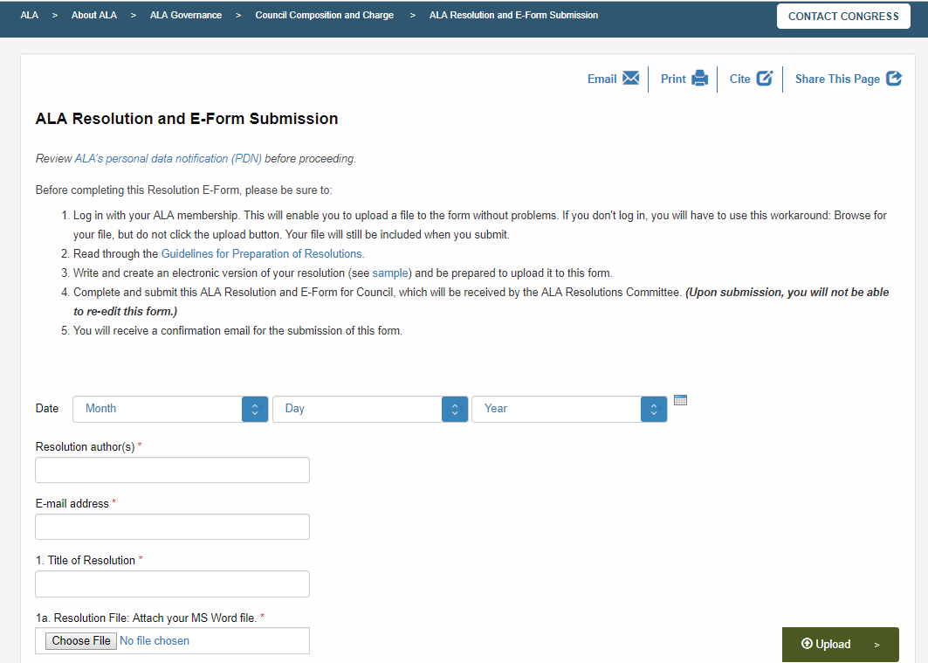
http://www.ala.org/aboutala/governance/council/resolutionwebform

Slide 4
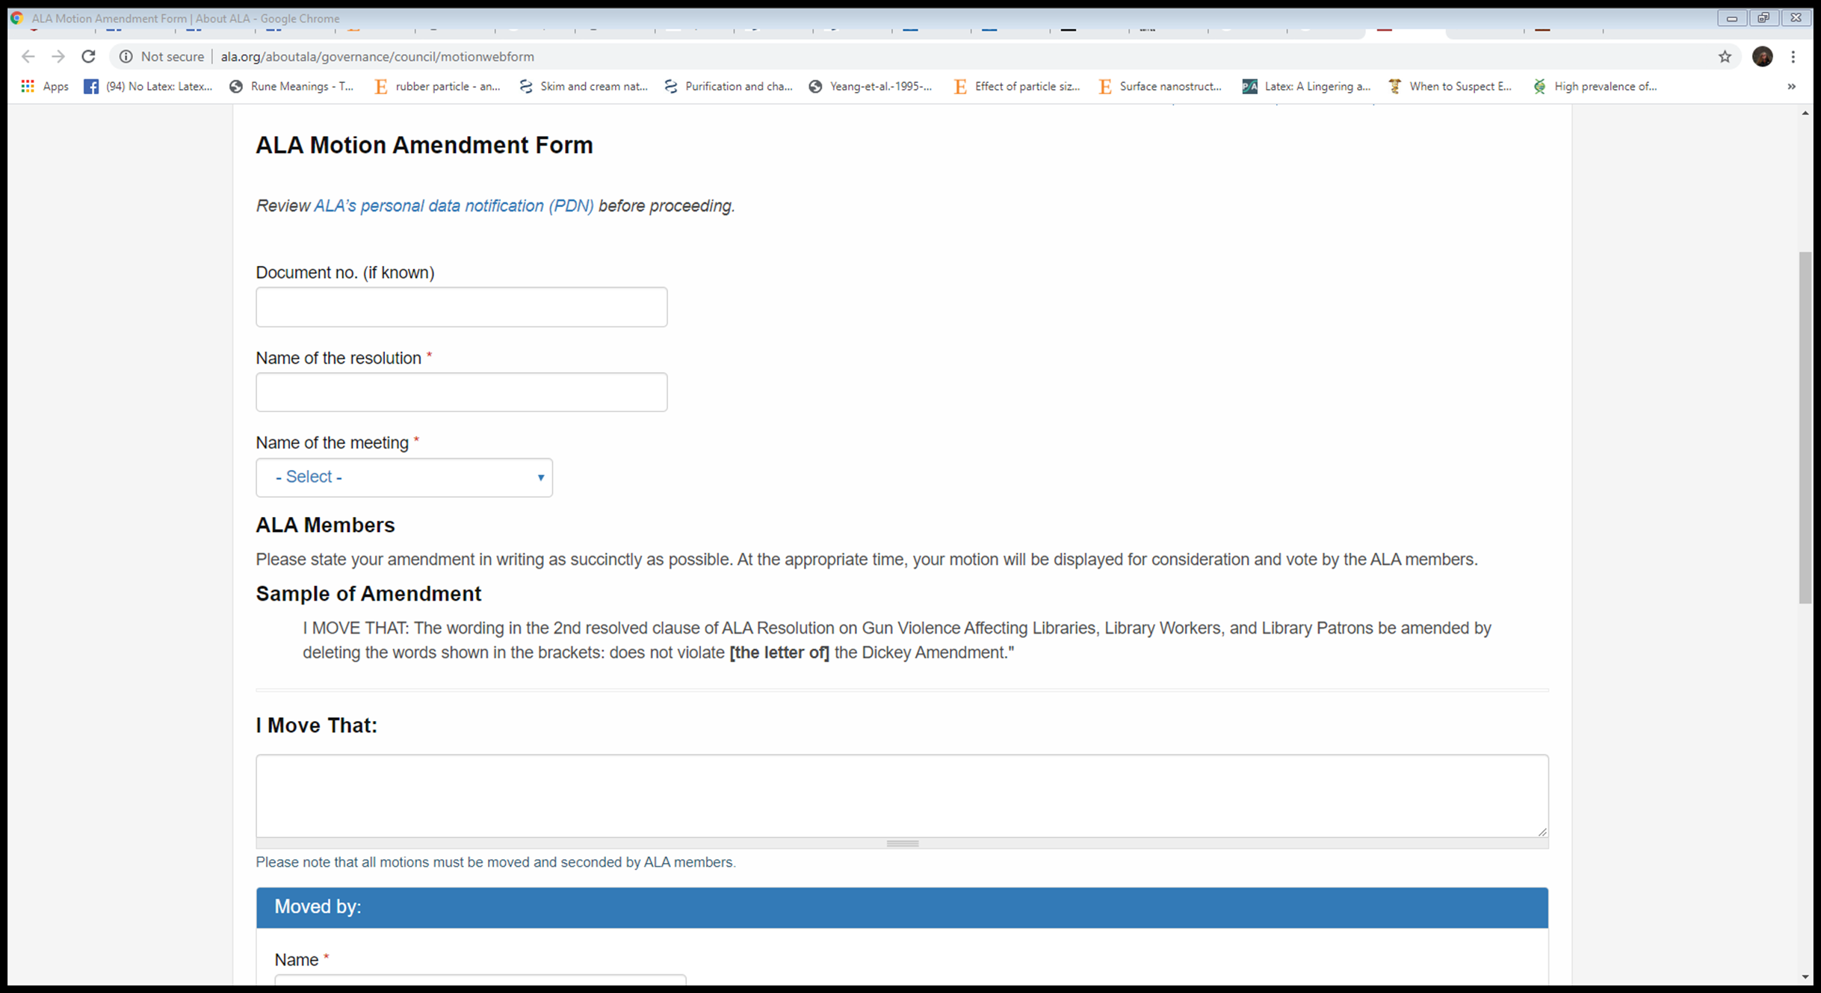
ALA Motion Amendment e-Form http://www.ala.org/aboutala/governance/council/motionwebform

Slide 5
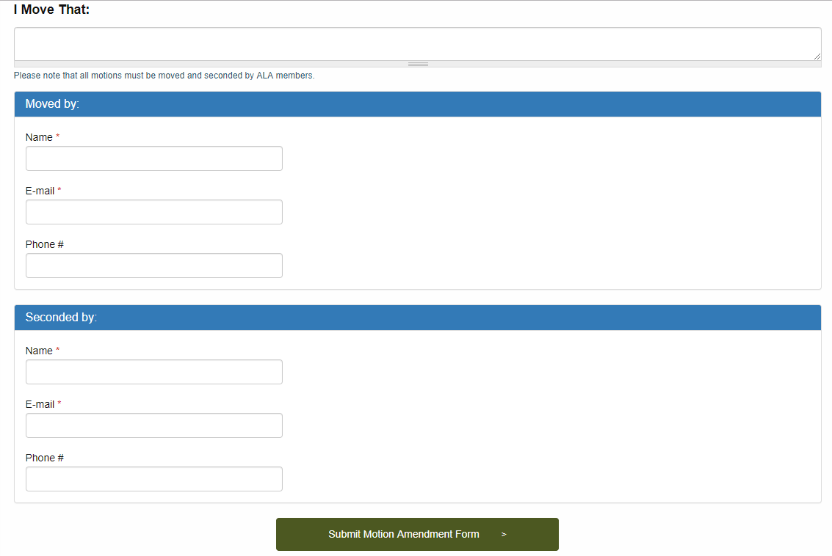
ALA Motion Amendment e-Form http://www.ala.org/aboutala/governance/council/motionwebform

Slide 6
Member Resolutions From Virtual Membership or Membership Meetings
Submit through E-form
If the resolution concerns:
Fiscal Implications
May be referred to BARC
Council Committee or Unit
May be referred to appropriate committee or unit
Existing policy
May be debated and voted upon by members in attendance
May be adopted at Virtual or Membership Meeting
Adopted resolutions are referred to Resolutions Committee Chair
Resolution is presented at Council I (Sunday)

Slide 7
Memorials Tributes and Testimonials
May be submitted by:
Members (requires a seconder)
Councilors (requires a seconder)
Committees (no seconder if in report)
Submitted on resolutions E-form
Reviewed by Resolutions Committee
Forwarded to Council Secretariat
Presented at:
Membership Meeting
Council III (Tuesday)
Sent to appropriate parties after Meeting

Slide 8
Resolutions from Council Members
Resolutions from Council Members:
Follow the Resolution Form and Content guidelines
Submitted via Resolutions Committee (E-form)
May be vetted on Council Listserv
May be vetted at Council Forum I, II, or III
Submitted to Council Secretariat
Placed on agenda of Council I, II, or III
If the resolution concerns:
Fiscal Implications
May be referred to BARC
Council Committee or Unit
May be referred to appropriate committee or unit
Existing policy
May be debated and voted upon by Council
(continues on next slide)

Slide 9
Resolutions from Council Members
(continued from previous slide)
Adoption followed by:
Directive, Dissemination, and Implementation
Included in Executive Director’s Report
If resolution changes ALA policy
Reviewed by Policy Monitoring Committee (PMC)
PMC reports to council on placement in Policy Manual
Council votes on Policy Manual revision
Policy Manual Updated following Council approval

Slide 10
ALA & Council Standing Committees
Not sent to Resolutions Committee, rather submitted within report to Council Secretariat
Follows Report/Action item format
May be vetted on Council Listserv
May be vetted at Council Forum I, II, or III
Placed on agenda of Council I, II, or III
Does the resolution concern:
Fiscal Implications
May be referred to BARC
Council Committee or Unit
May be referred to appropriate committee or unit
Existing policy
May be debated and voted upon by Council
(continues on next slide)

Slide 11
ALA & Council Standing Committees
(continued from previous slide)
Adoption followed by:
Directive, Dissemination, and Implementation
Included in Executive Director’s Report
If resolution changes ALA policy
Reviewed by Policy Monitoring Committee (PMC)
PMC reports to council on placement in Policy Manual
Council votes on Policy Manual revision
Policy Manual Updated following Council approval

Slide 12
Role Playing with Resolution on Monetary Library Fines as a Form of Social Inequity
The Resolution on Monetary Library Fines as a Form of Social Inequity will be used as an example (time permitting)
RC Chair acts as Presiding Officer and introduces the Orientation Resolution and asks the sponsor (volunteer) to come to the microphone to read the Resolved clause(s).
The Resolved clauses appear on the projection screen.
A second (volunteer) is asked to come to the microphone.
Discussion of the resolution.
With ALA Parliamentarian Eli Mina’s assistance walk through subsidiary motions using the print form first and then the electronic form.
Presiding officer Encourages councilors to approach the mic to speak to the motion.
An RC member can ultimately call for the vote.

Slide 13
Top 10 issues that confuse Council
24 Hour Rule
Wordsmithing
Amendments
Point of Privilege
Tributes and Point of Privilege
Policy Monitoring Committee review and report
Motion to Refer
BARC review
Point of Order
Resolutions from Council vs. Committees

Slide 14
Resolutions Committee Service Schedule/Office Hours
Pennsylvania Conference Center, ALA Council Chambers
Terrace IV Ballroom and via our Zoom Office Hours
Saturday, June 22
9:30am – 11:00am
11:00am - 12:30pm
1:30pm - 2:30pm (ALA Resolutions Committee Meeting, PCC, Terrace IV Ballroom)
Sunday, June 23
1:00pm - 2:30pm
2:30pm - 4:00pm
Monday, June 24
1:00pm - 2:30pm
Join Zoom Online Office: https//:ala-events.zoom.us/i/272833140
Meeting ID: 272 833 140
Schedule Notes
Eli Mina, ALA Parliamentarian, will also be available at the ALA Resolutions Table for consultation as his schedule permits
For information about the Zoom Online Office Hours Feature, please see:
http://www.ala.org/aboutala/governance/council/resolution_guidelines
Information about the resolution process:
Proposed resolutions can be submitted to the Resolutions Committee at:
alaresolutions@ala.org
An online training series for resolution preparation is available at:
http://www.ala.org/aboutala/governance/council/resolution_guidelines
Questions, comments and/or feedback re: the resolution process can be sent to:
ala-resolution-feedback-request@ala.org
WANT TO LEARN MORE?

Slide 15
Thank you!

