Slide 1
ALA Treasurer’s Report
2024-2025 ALA CD #13.1 2025 ALA Annual Conference
Virtual Membership Meeting
June 16, 2025

Slide 2
FY 2025 YTD Financial Results
For the Seven Months Ended
March 31, 2025

Slide 6
FY 2026 Budget Objectives

Slide 7
Budget Objectives
Strengthen focus on financial stability and growth
Deliver neutral revenue/expense budget results
Diversify and grow revenue sources
Reduce expenditures through consolidation and further efficiencies

Slide 8
FY 2026 Budget Overview

Slide 9
FY2026 Budget Overview
Potential improvements:
-$1 million in
Endowment
payouts
-$2.5 million in
Organizational
Assessment
recommenda-
tions

Slide 10
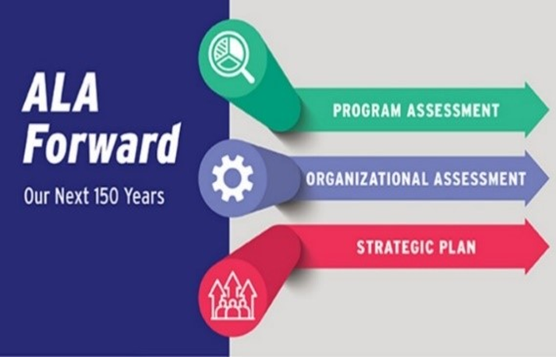
ALA Forward

Slide 11
ALA Forward
Program Assessment: evaluate awards and member groups to create stronger programs that advance our mission, meet member needs and responsibly use ALA resources.
Organizational Assessment: align ALA’s functions and resources with its strategic goals to enhance efficiency, effectiveness, and overall impact.
Strategic Plan: clarify what ALA does and why.

Slide 12
ALA Forward addresses:
ALA's necessary evolution to meet the changing landscape of libraries, information services, and member needs.
The need for program adjustments.
ALA’s requirement to champion and support libraries.

Slide 13
ALA Forward
Steps currently being taken for financial sustainability and streamlining governance:
reunification of YALSA with ALSC
ALA staff voluntary Career Incentive Program
dissolution of ALA-APA Council

Slide 14
Enjoy the ALA Annual Conference!

