Slide 1

Forward Together
Working Group
2020-2021 ALA CD#51
2020 ALA Virtual Dec. Council Meeting
Update for Council
Notes:
Joslyn

Slide 2
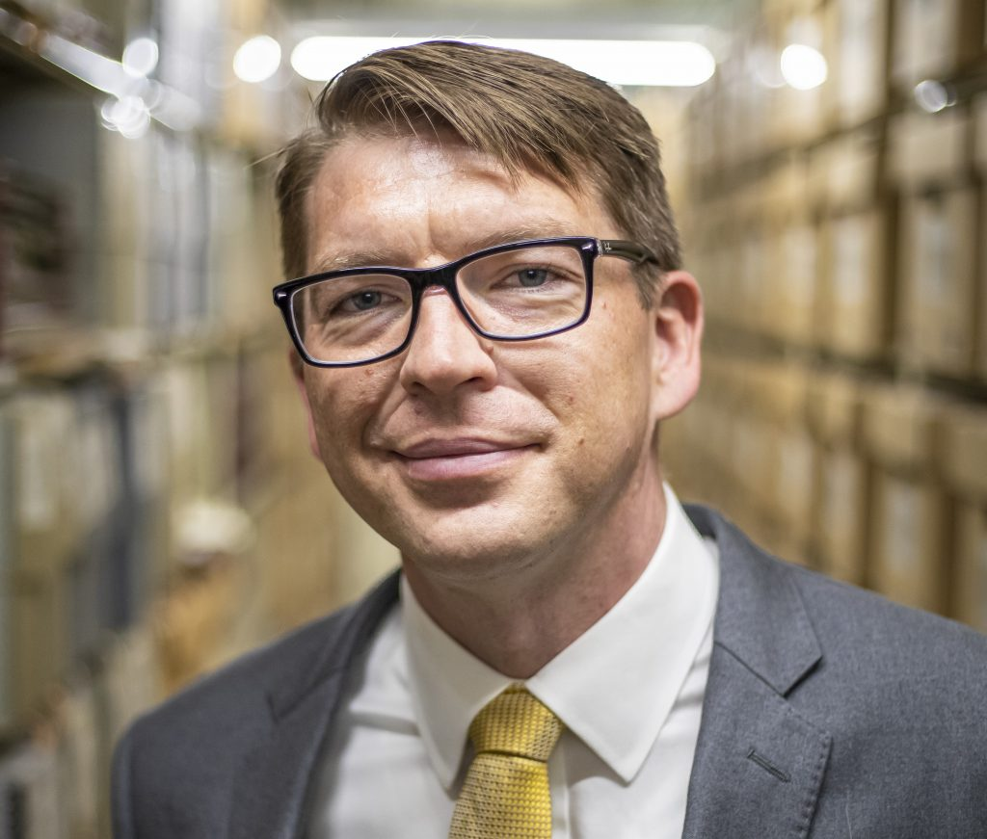
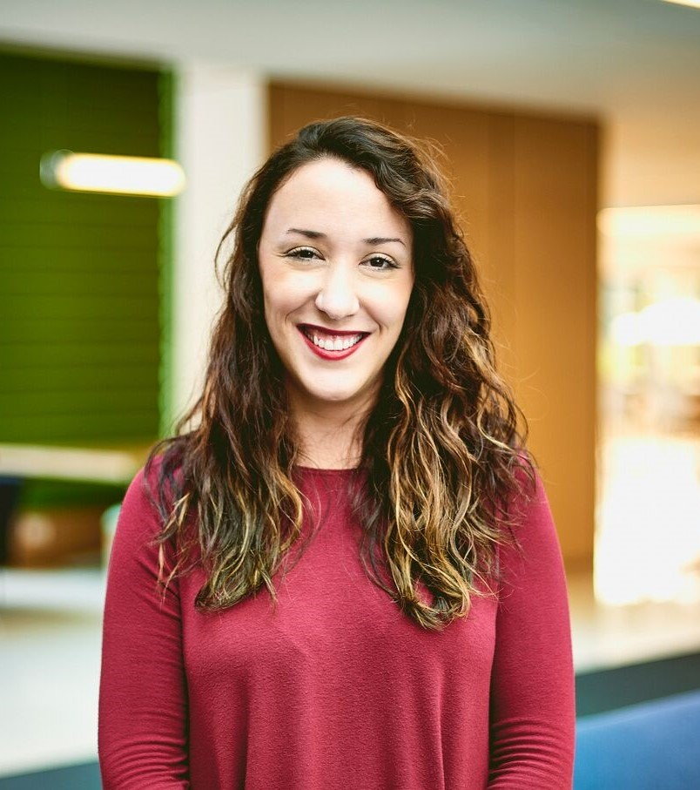
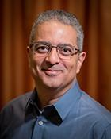
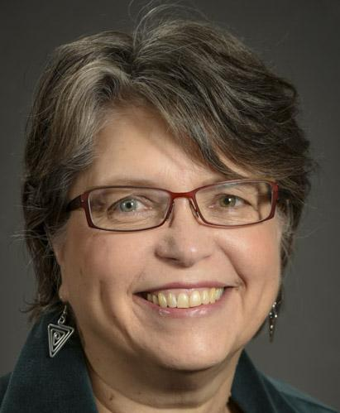
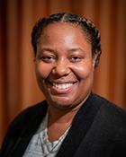
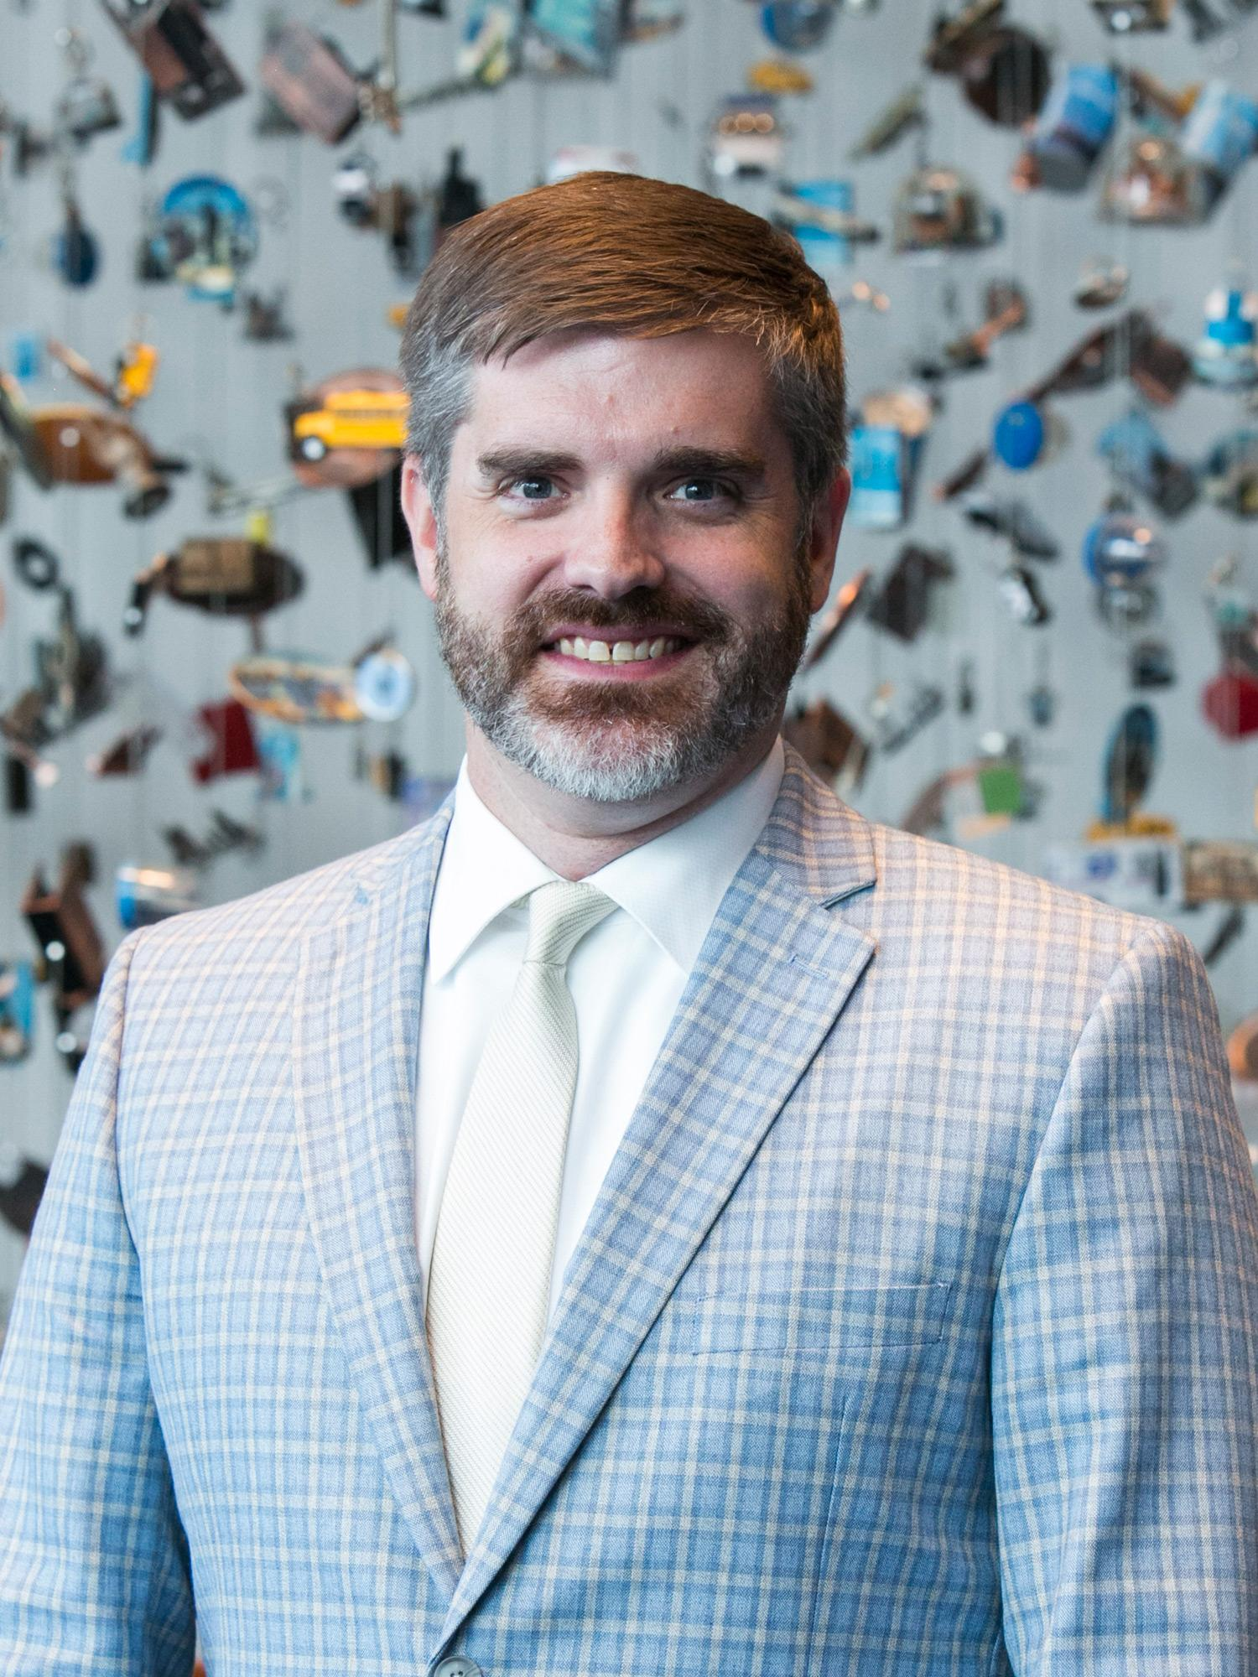
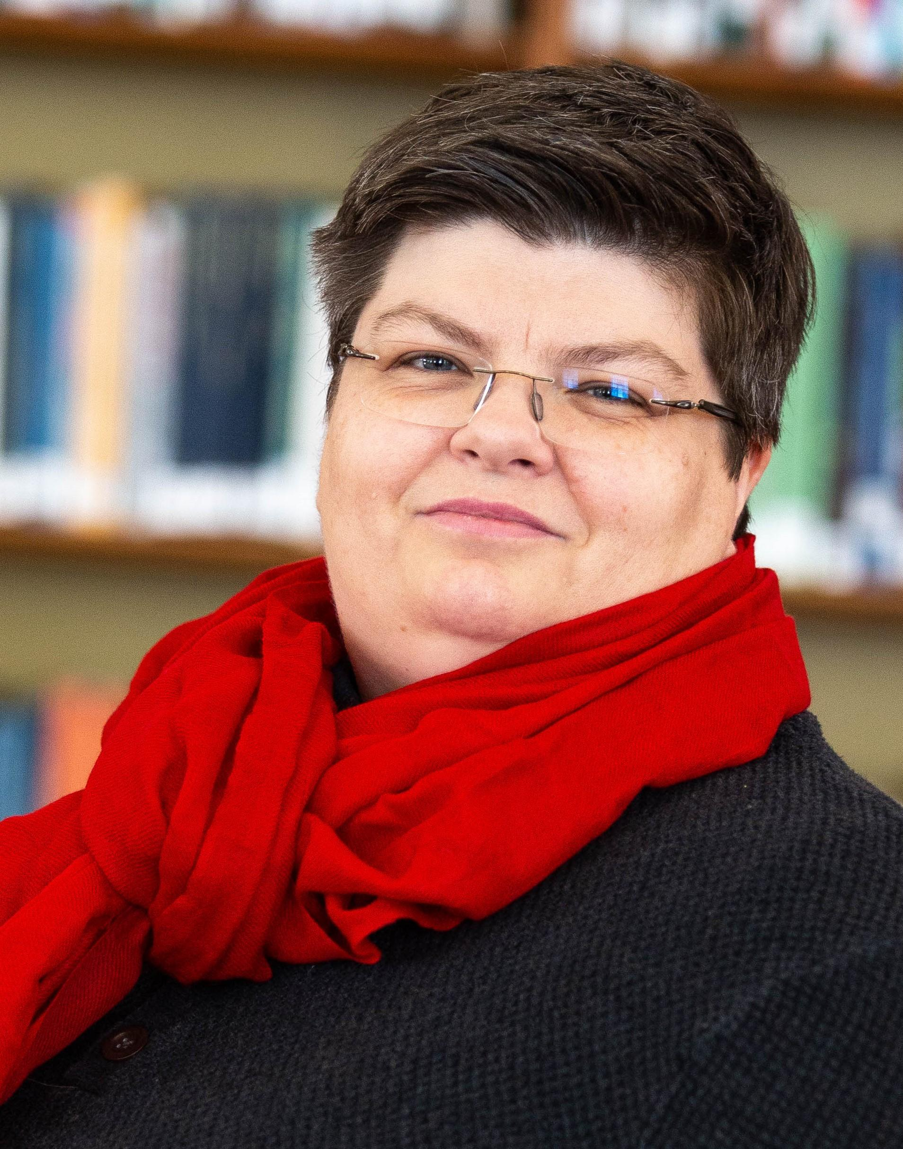
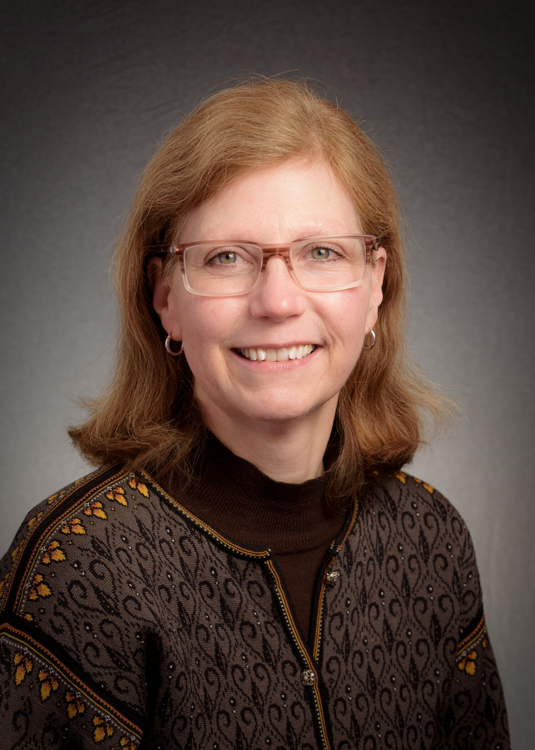
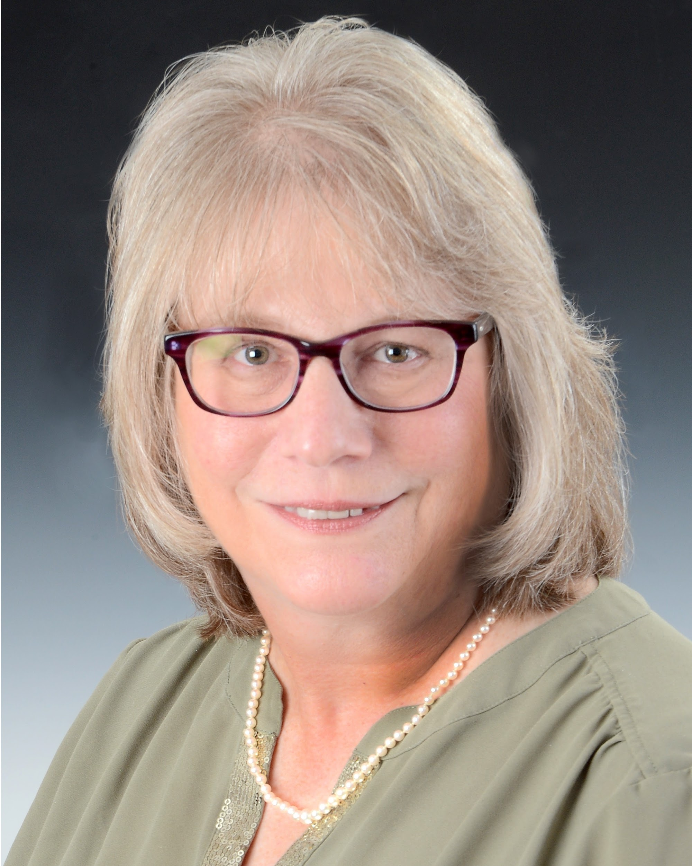
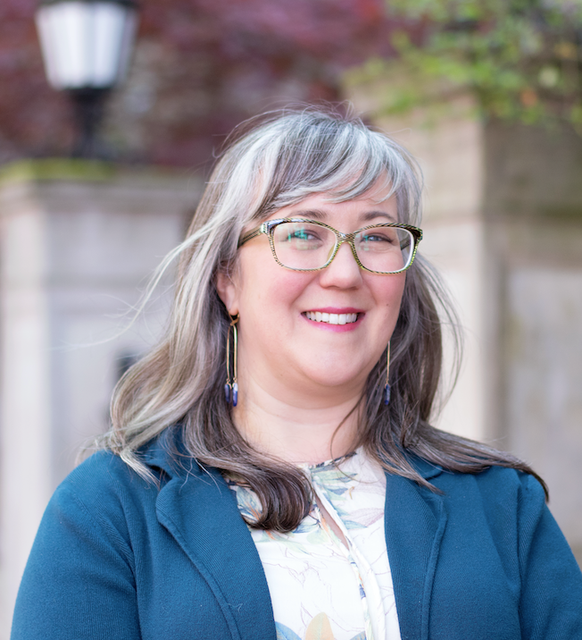
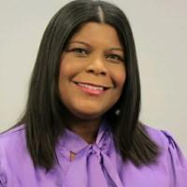
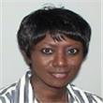
Members
Ben Hunter Camila Alire Christina Rodriques Ed Garcia Erika Linke Eboni Henry Steven Yates
JJ Pionke Joslyn Bowling-Dixon Lesliediana Jones Meg Delaney Sara Dallas Stephanie Chase
Notes:
Joslyn

Slide 3
Forward Together Working Group Mission
Through the remainder of 2020, the Forward Together Working Group is hosting a series of two-hour discussion sessions for current Councilors, focusing on the elements of the Forward Together recommendations that have the greatest lack of consensus. This is to give current Councilors time to review, consider, discuss and provide feedback to the Working Group so final recommendations can be brought forward for a Council vote.
)
Notes:
Steven

Slide 4
The Process: Outward Facing
Pertinent Document microsite:https://forwardtogether.ala.org/index.php/reports/.
Background/Origin Story Provided on Forward Together Working Group microsite
Ground Rules set for each session
Notes:
Steven

Slide 5
The Process: Behind the Scenes
ALA Connect Page
Forward Together Working Group meets bi-weekly on Mondays from 3PM-5PM CST
Slides from Friday sessions as well as Zoom transcript provided after each session
Post-session meeting with FTWG to prep for Monday meetings
Draft and send replies concerning FTWG to Council Listserv
Notes:
Joslyn

Slide 6
Timeline for Council Information Sessions
8/28 ☑ALA Core Values
9/11 ☑ Election and Appointment of the Board of Directors; Size of the Board
9/25 ☑ Elected and Appointed members to ALA Committees
10/9 ☑ 1% Threshold for Round Table creation
11/6 ☑ Shared Round Table Governance Docs, Policies and Procedures
11/20 ☑ Redistribution of the functions of Council to other areas of the Assoc.
Notes:
Joslyn

Slide 7
Council Information Session 1: Core Values
Do you have a better understanding of Forward Together and Core Values?
How can the Core Values be better represented in ALA?
What are your concerns about Core Values in Forward Together?
What additional information do you need to make a decision regarding Core Values and ALA?
What are some ways we can respond to your questions or concerns?
Notes:
Steven

Slide 8
Council Information Session 2:
Board of Directors
Do you have a better understanding of Forward Together and the ALA Board of Directors?
How can the ALA Board of Directors be better improved?
What are your concerns about the ALA Board of Directors in Forward Together?
What additional information do you need to make a decision regarding the ALA Board of Directors?
What are some ways we can respond to your questions or concerns?
Notes:
Steven

Slide 9
Council Information Session 3: ALA Committees
Do you have a better understanding of the Forward Together process and the SCOE recommendations on ALA Committees?
How can the ALA Committee recommendations be better improved?
What are your concerns about ALA Committees in Forward Together?
What additional information do you need to make a decision regarding ALA Committees?
What are some ways we can respond to your questions or concerns?
Notes:
Steven

Slide 10
Council Information Session 4:
1% Threshold for Roundtables
What recommendations do you have for changes if the 1% limit for roundtable creation is abandoned?
Based on the commentary you have heard from others are there aspects you agree or disagree with?
Notes:
Joslyn

Slide 11
Council Information Session 5:
Roundtable Governing Documents
What might cohesive bylaws look like that create equity across round tables?
What level of bylaws/constitution/some other governing document should the round tables adopt?
Notes:
Joslyn

Slide 12
Council Information Session 6: Council
Do you have a better understanding of Forward Together and how aspects of Council could be redistributed to other parts of the Association?
What are your concerns about changing the structure of Council in Forward Together?
What additional information do you need to make a decision regarding the functions of Council ALA?
What are some ways we can respond to your questions or concerns?
Notes:
Joslyn

Slide 13
Where We’ve Captured the Flavor of the Conversations
https://forwardtogether.ala.org/index.php/reports/
Notes:
Joslyn & Steven

Slide 14
The follow-up survey launched on November 25.
https://www.surveymonkey.com/r/X5KHQJZ
The survey closes on December 9 at 5pm CT.
Our goal: 100% Council engagement with this survey!
Notes:
Steven

Slide 15
What’s Ahead for the Forward Together Working Group
December 9 - January 8: Complete Report for Council integrating survey results
Midwinter 2021: Report Presented at Council Session
Notes:
Joslyn

Slide 16
We Welcome Your Feedback
COMPLETE THE SURVEY!
forwardtogether@ala.org

