Slide 1

EBD #13.1
ALA CD #16
BARC #13.1
2019 – 2020 Midwinter Meeting
Endowment Trustee Report
ALA Executive Board, Council, and Membership
Membership Information Session
Patricia Wand – Senior Endowment Trustee
Midwinter Meeting – Philadelphia, PA
Saturday – January 25, 2020
Notes:
Endowment Trustee’s Report at the Information Session
to the ALA Executive Board and ALA Council
Rod Hersberger – Senior Endowment Trustee
Saturday June 23, 2018
Sunday June 24, 2018

Slide 2
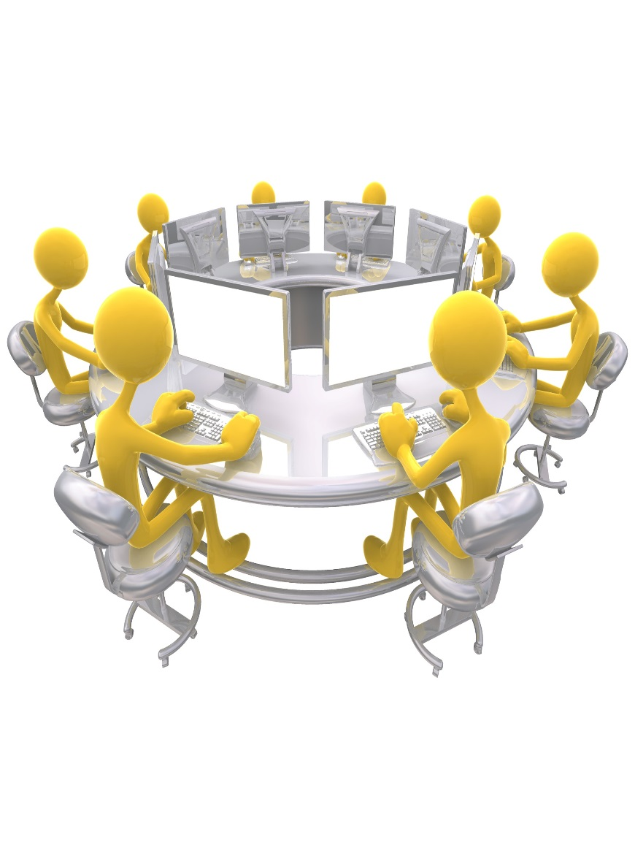
ALA Endowment Trustees
Patricia A. Wand, Senior Trustee, 2015 – 2021
Mario Gonzalez 2017 - 2020
James G. Neal 2019 - 2022
Robert Newlen 2013 – 2020
Brian E. C. Schottlaender 2015 - 2021
Janice Welburn 2019-2022
Maggie Farrell, Treasurer
Supported by ALA Finance Office staff and Merrill Lynch Investment Advisers
Charge
To hold, invest, reinvest and disburse endowment funds as directed by the Executive Board; recommend endowment operating procedures and assumptions to the Executive Board; select endowment investment managers; report endowment status to the Executive Board, Council and Membership.
Notes:
The work of the Trustees – recent actions
Reviewed Blackstone payout – “J” Curve
- Investments begins payoff shortly
Made no recommended changes to the portfolio’s asset
allocation between equites (64%), bonds (24%) and
alternatives (12%)
Reviewing two new ESG investments
- Preliminary review at the spring meeting
- Final review at the fall meeting
Review portfolio holdings
- Made access to portfolio holdings available to Council &
membership
Implemented a Senior Trustee succession plan
“Strategic Review” of the Endowment
- Interviewing consulting candidates

Slide 3
Market and Book Value @ 12-31-19*
$54,260,268
Exhibit #1
*Calendar year to date (twelve months) through 12-31-19

Slide 4
World Market Performance
Calendar Year Market Returns @ 12-31-19
Exhibit #2
Notes:
FTSE 100 -8.2% Dow Jones -0.2% Hang Seng 3.0% Euro Stoxx 1.0% NASDAQ 8.3% ML US Broad Market Bonds -1.5% DAX -2.4% Nikkei 225 -1.7% Shanghai Comp -6.1% S&P 500 2.0% ALA Endowment 1.4%

Slide 5
Time Weighted Rate of Return
Exhibit #3
 | Opening | Contributions (Withdrawals) | Interest / Dividends | Appreciation / Depreciation | Closing | ROR | ROR
Period | Balance |  |  |  | Balance | Period | Cumulative
December – 2019 | $ 48,440,171 | $ 5,015,185 | $ 375,794 | $ 429,118 | $ 54,260,268 | 1.58% | 19.44%
November – 2019 | $ 47,411,249 | $ 9,724 | $ 45,771 | $ 973,427 | $ 48,440,171 | 2.15% | 17.59%
October – 2019 | $ 47,121,666 | $ (428,672) | $ 101,186 | $ 617,068 | $ 47,411,249 | 1.56% | 15.12%
September – 2019 | $ 46,736,916 | $ - | $ 95,811 | $ 288,939 | $ 47,121,666 | 0.82% | 13.34%
August – 2019 | $ 47,203,068 | $ - | $ 45,073 | $ (511,225) | $ 46,736,916 | -0.98% | 12.42%
July – 2019 | $ 47,464,621 | $ (587,103) | $ 83,883 | $ 241,668 | $ 47,203,068 | 0.68% | 13.53%
June – 2019 | $ 45,517,657 | $ - | $ 130,612 | $ 1,816,352 | $ 45,615,049 | -13.00% | 12.77%
May – 2019 | $ 47,281,573 | $ - | $ 51,558 | $ (1,815,474) | $ 45,517,657 | -3.73% | 8.14%
April – 2019 | $ 45,955,726 | $ - | $ 69,598 | $ 1,256,248 | $ 47,281,573 | 2.89% | 12.33%
March – 2019 | $ 45,383,035 | $ - | $ 92,661 | $ 480,030 | $ 45,955,726 | 1.26% | 9.18%
February – 2019 | $ 44,443,399 | $ - | $ 78,617 | $ 861,019 | $ 45,383,035 | 2.11% | 7.82%
January – 2019 | $ 42,091,092 | $ - | $ 20,118 | $ 2,332,190 | $ 44,443,399 | 5.59% | 5.59%
Total | $ 45,900,664 | $ 4,009,133 | $ 1,190,682 | $ 6,969,361 | $ 54,260,268 | NA | 19.44%
*Rate of Return
Notes:
Time Weighted Rate of Return @ 5-31-18
May 2018 Opening Balance - $45,028,467, Contributions/(Withdrawals) - $0, Interest/Dividends - $52,272, Appreciation/(Depreciation) – ($592,657), Closing Balance - $45,673,395, Rate of Return for the period – (1.43%) and Rate of Return Cumulative (1.37%).

Slide 6
Managers, Styles, and Allocations
Exhibit #4
 |  |  | Annual
Manager | Value | % | Performance
Equity Income & Growth - ETF | $ 9,976,312 | 18.4% | 27.7%
Clearbridge ESG - Large Cap Core | $ 12,946,552 | 23.9% | 32.5%
Merrill Lynch Personal Advisor* - (MLPA) | $ 23,436,854 | 43.2% | - Next Slide -
The Endowment Fund/KKR/Blackstone - Alternatives | $ 4,518,227 | 8.3% | **
Capital Group - International | $ 2,660,728 | 4.9% | 28.6%
Cash | $ 721,595 | 1.3% | -
Total | $ 54,260,268 | 100.0%
*MLPA is a platform under which ALA can access different managers of various investing styles in the form of mutual funds and ETF’s - 12 managers.
**JLL (5.6%), Endowment Fund (2.1%), KKR/Blackstone & the Partners Group TBD
Notes:
Manager Allocation and Style
Manager Value %
Clearbridge ESG - Large Cap Core $9,498,873 20.8%
Merrill Lynch Personal Advisor* - (MLPA) $21,971,967 48.1%
The Endowment Fund/KKR/Blackstone/ JLL - Alternatives
$ 3,920,637 8.6%
Capital Group – International $ 2,110,627 4.6%
Equity Income & Growth – ETF $ 8,171,292 17.9%
Total $44,824,221 100.00%

Slide 7
Merrill Lynch Personal Advisor
Managers, Style, and Allocations
Exhibit #5
 |  |  | Annual
Manager | Value | % | Performance
Principal Midcap Fund | $ 2,815,263 | 12.0% | 42.9%
Calvert Short Duration | $ 2,742,911 | 11.7% | 6.5%
Doubleline Total Return | $ 2,527,507 | 10.8% | 5.8%
Guggenheim Total Return | $ 2,492,160 | 10.6% | 4.7%
Lord Abbett Short | $ 2,484,585 | 10.6% | 5.5%
Domini Impact International | $ 1,129,442 | 4.8% | 17.0%
Lazard International Strategic | $ 1,252,596 | 5.3% | 21.6%
Nuveen ESG Small Cap | $ 1,625,399 | 6.9% | 27.1%
Nuveen Real Asset Income | $ 1,356,481 | 5.8% | 21.4%
Oakmark International | $ 1,235,204 | 5.3% | 24.2%
Pimco Income Fund | $ 2,401,550 | 10.2% | 8.0%
Vanguard Real Estate | $ 1,373,756 | 5.9% | 28.9%
Total | $ 23,436,854 | 100.0%
Notes:
Manager Allocation and Style
Manager Value %
Clearbridge ESG - Large Cap Core $9,498,873 20.8%
Merrill Lynch Personal Advisor* - (MLPA) $21,971,967 48.1%
The Endowment Fund/KKR/Blackstone/ JLL - Alternatives
$ 3,920,637 8.6%
Capital Group – International $ 2,110,627 4.6%
Equity Income & Growth – ETF $ 8,171,292 17.9%
Total $44,824,221 100.00%

Slide 8
Endowment Performance as of 8-31-19*
Exhibit #6
Annualized Benchmark Comparison | 1 Year | 3 Years | 5 Years | 10 Years
Gross Returns | 3.2% | 8.5% | 6.1% | 8.2%
Net Returns | 2.6% | 7.8% | 5.5% | 7.6%
Benchmark 1 Policy | 4.4% | 8.0% | 6.4% | 9.1%
Benchmark 2 Inflation – Consumer Price Index + 4% | 4.0% | 5.9% | 6.1% | 5.6%
June 30, 2018 NACUBO Peer Comparisons** | 1 Year | 3 Years | 5 Years | 10 Years
ALA Endowment | 9.9% | 6.8% | 8.1% | 6.8%
Endowments under $25 million | 7.6% | 6.2% | 7.5% | 5.8%
Endowments $25 million - $50 million | 7.5% | 6.0% | 7.0% | 6.1%
Endowments $51 million - $100 million | 7.7% | 6.0% | 7.0% | 5.7%
Endowments $101 million - $250 million | 7.9% | 6.0% | 7.1% | 5.6%
Endowments $251 million - $500 million | 8.5% | 6.1% | 7.3% | 5.7%
Endowments $501 million - $1 billion | 8.7% | 6.2% | 7.4% | 5.6%
*Top half of chart as of 8-31-19
**Source: 2018 study of college & university endowment returns
Notes:
Manager Allocation and Style
Manager Value %
Clearbridge ESG - Large Cap Core $9,498,873 20.8%
Merrill Lynch Personal Advisor* - (MLPA) $21,971,967 48.1%
The Endowment Fund/KKR/Blackstone/ JLL - Alternatives
$ 3,920,637 8.6%
Capital Group – International $ 2,110,627 4.6%
Equity Income & Growth – ETF $ 8,171,292 17.9%
Total $44,824,221 100.00%

Slide 9
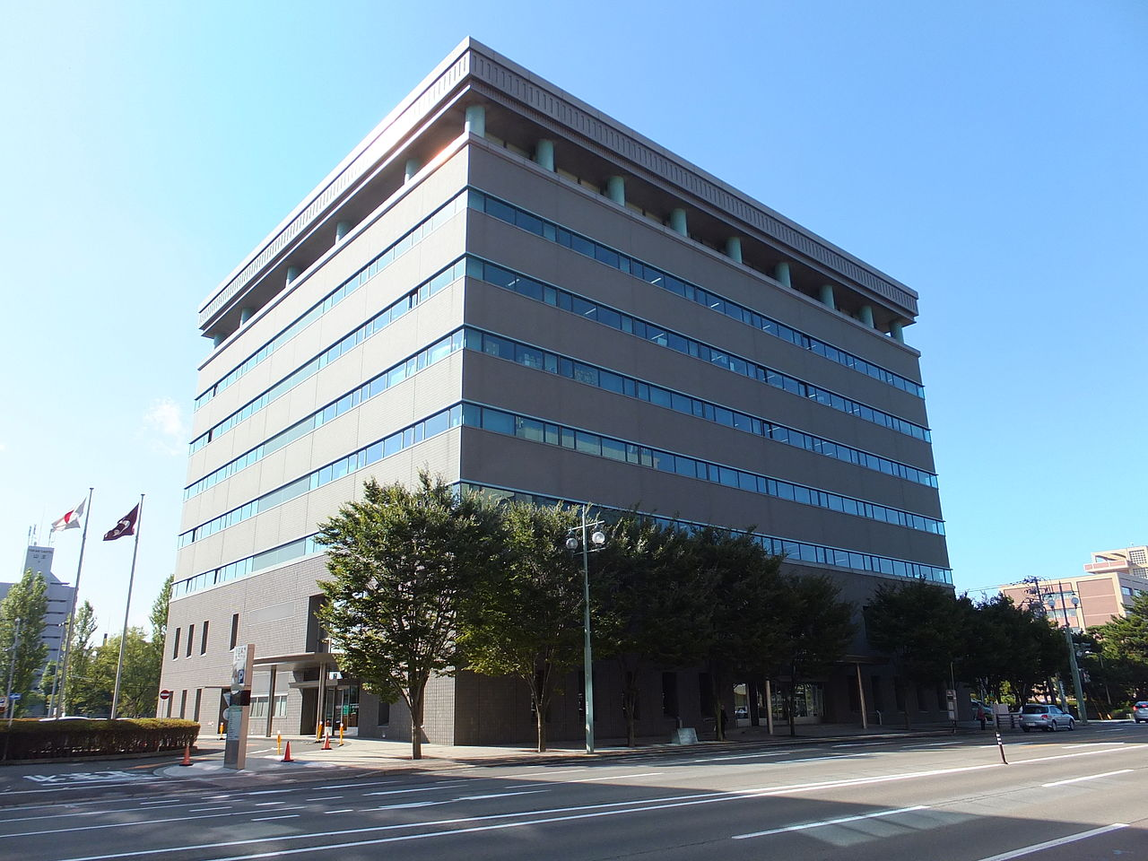
Proceeds from sale of ALA Headquarters
Exhibit #7
Gross Sale Price* $ 6,750,000
Consultant fees ($ 270,000)
2 months rent @
old headquarters ($ 110,000)
Deposit*** ($ 250,000)
Other Expenses ($ 24,000)
Net Proceeds from Sale $ 6,096,000
Transfer to Endowment ($ 5,000,000)
Transfer to WC** ($ 1,000,000)
Remaining Balance $ 96,000
*Sale price subject to increase provided additional/future investment criteria are met.
**ALA Working Capital account, which provides interest income to General Fund. ***To be reimbursed at a later date

Slide 10
Endowment Trustee Activity – 2019-2020
Exhibit #8
Rebalanced portfolio to meet target asset allocation for fixed income to the minimum level of 25%
Liquidated investment in the AQR Long/Short equity fund and reallocated equally among portfolio’s five fixed income managers. ($1.4 million – 3%)
Equities (65.9%), fixed Income (24.9%) and Alternatives (9.2%)
Plan for maintaining balance of $50,000 for small endowed accounts
Examine Endowment Trustee operations and expenses
Expand Trustee education based on 2018-2019 Strategic Review
  Sr. Trustee attended Commonfund Investment Stewardship Academy
  Participated in Commonfund Investment Survey to collect personal responses, analyze results, and compare to peer group investors
Published electronic Policy and Procedure Manual on Endowment Trustee web page
Notes:
The work of the Trustees – recent actions
Reviewed Blackstone payout – “J” Curve
- Investments begins payoff shortly
Made no recommended changes to the portfolio’s asset
allocation between equites (64%), bonds (24%) and
alternatives (12%)
Reviewing two new ESG investments
- Preliminary review at the spring meeting
- Final review at the fall meeting
Review portfolio holdings
- Made access to portfolio holdings available to Council &
membership
Implemented a Senior Trustee succession plan
“Strategic Review” of the Endowment
- Interviewing consulting candidates

Slide 11
ALA Endowment Trustees
CONTACT: patwand@american.edu
Patricia A. Wand, Senior Trustee, 2015 – 2021
Mario Gonzalez 2017 - 2020
James G. Neal 2019 - 2022
Robert Newlen 2013 – 2020
Brian E. C. Schottlaender 2015 - 2021
Janice Welburn 2019-2022
Maggie Farrell, Treasurer
Supported by ALA Finance Office staff and Merrill Lynch Investment Advisers
Charge
To hold, invest, reinvest and disburse endowment funds as directed by the Executive Board; recommend endowment operating procedures and assumptions to the Executive Board; select endowment investment managers; report endowment status to the Executive Board, Council and Membership.
Notes:
The work of the Trustees – recent actions
Reviewed Blackstone payout – “J” Curve
- Investments begins payoff shortly
Made no recommended changes to the portfolio’s asset
allocation between equites (64%), bonds (24%) and
alternatives (12%)
Reviewing two new ESG investments
- Preliminary review at the spring meeting
- Final review at the fall meeting
Review portfolio holdings
- Made access to portfolio holdings available to Council &
membership
Implemented a Senior Trustee succession plan
“Strategic Review” of the Endowment
- Interviewing consulting candidates

