Slide 1
ALA-APA Financial Results August 31, 2024
ALA-APA CD #4
2024-2025
Peter Hepburn – Treasurer
Saturday – January 25, 2025
LibLearnX – Phoenix, AZ

Slide 2
ALA-APA Focus
Provides national certification for library workers
Certified Public Library Administrator Program
Library Support Staff Certification Program
Advocates for salaries and training for library workers
Provides reports and analyses
Librarian Salary Survey (every 2 years)
Non-MLS Salary Survey (every 5 years)
Library Salary Database

Slide 3
ALA-APA Operating Summary August 31, 2024
 | Actual | Budget | Variance
Total Revenue | $ 222,535 | $ 184,000 | $ 38,535
Total Expenses | 123,249 | 162,270 | 39,022
Net Surplus | $ 99,286 | $ 21,730 | $ 77,557
Notes:
At their Fall meetings, both BARC and F&A recommended to the Executive Board, based on the FY18 year-end results, approval to pay off the outstanding loan of $41,457. The payment was made in FY 2019 and the loan has officially been retired.

Slide 4
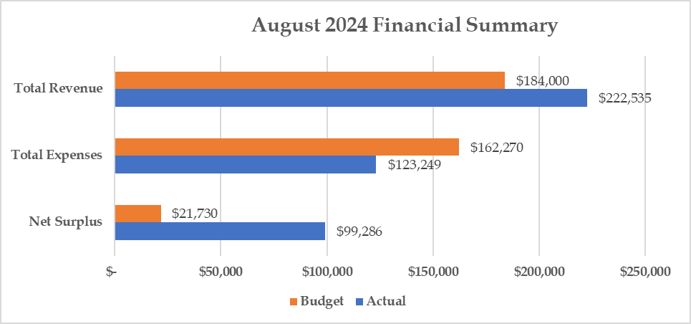
ALA-APA Operating Summary August 31, 2024
Notes:
ALA APA did well in 2018. Although revenue was slightly higher than 2017 at $153,428, their expenses were lower by $15,150 (-14.4%) at $90,005. Net revenue of $63,423 was $18,236 higher than 2017 and better than budget by $35,007.

