Slide 1
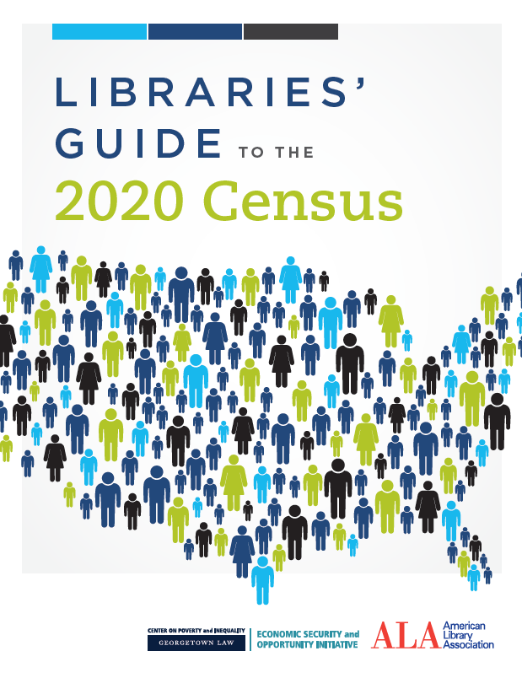
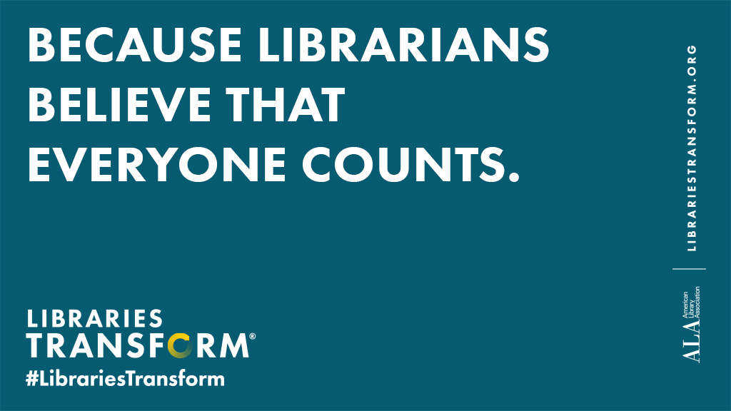

2020 Census: Key Facts for Libraries

Slide 2
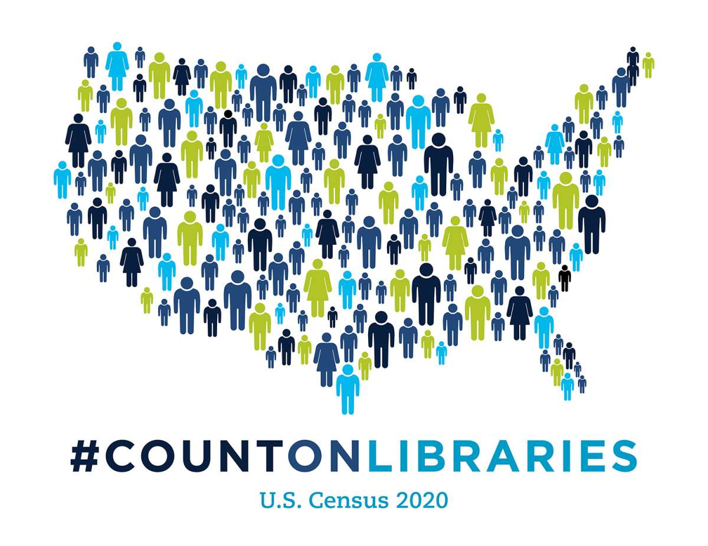
What’s ahead?
What is the census, and why is it important?
Who is at risk for not being counted?
How will the 2020 Census work?
What can libraries do?
QA/discussion

Slide 3
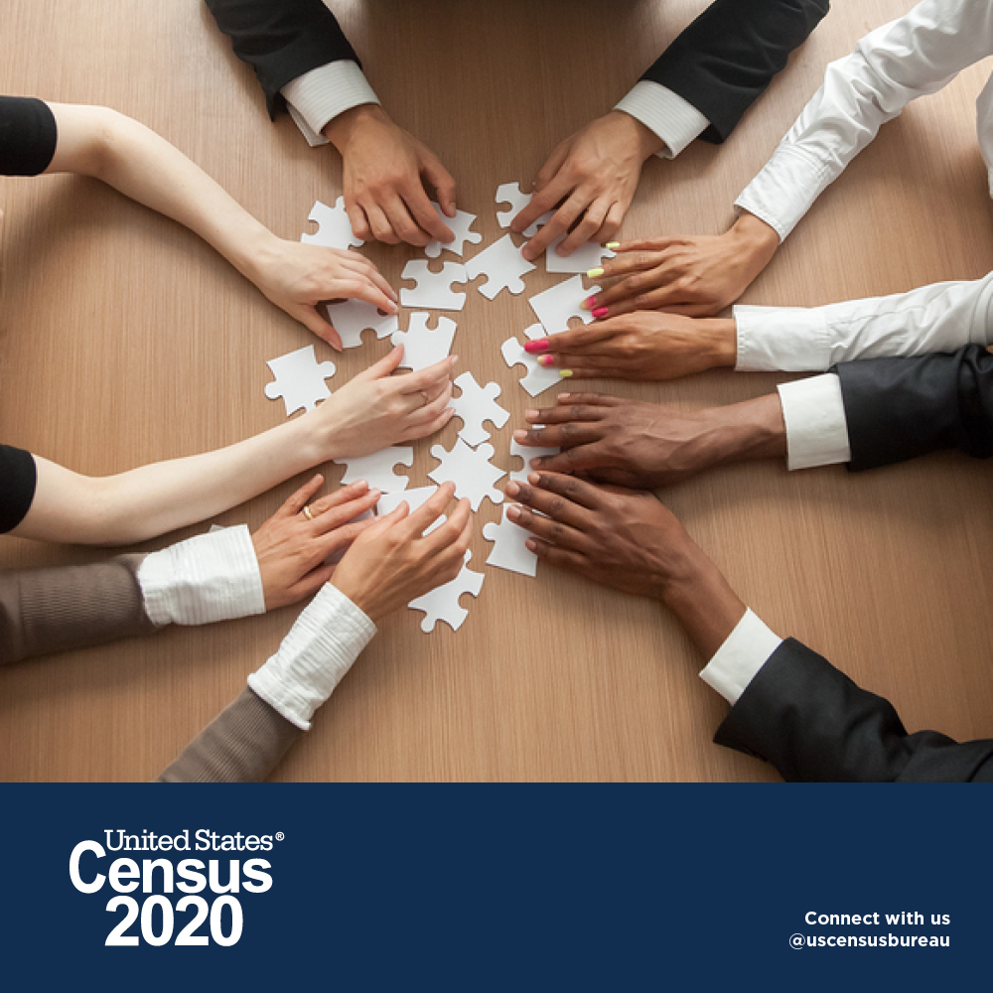
What is the decennial census?
It’s in the constitution.
Count every person in the U.S. once, and only once, and in the right place.
Essential for:
Federal funding
Political representation
Informed decision-making

Slide 4
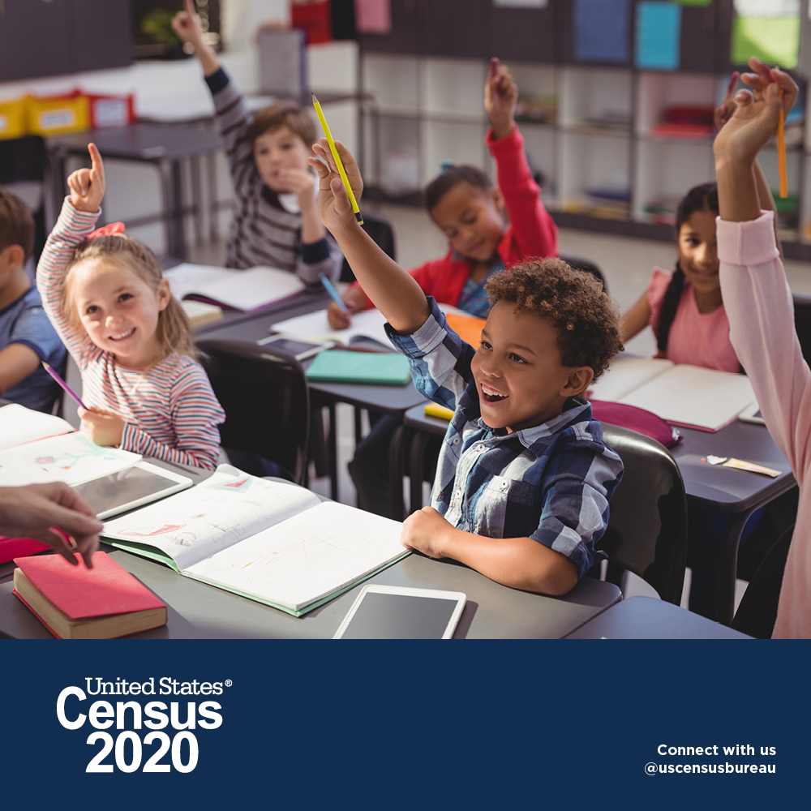
Does the census affect funds for my community?
YES!
Help your community get its fair share for schools, health centers, roads, housing assistance and other vital programs.
National School Lunch Program
Medicare
SNAP
IMLS state grants

Slide 5
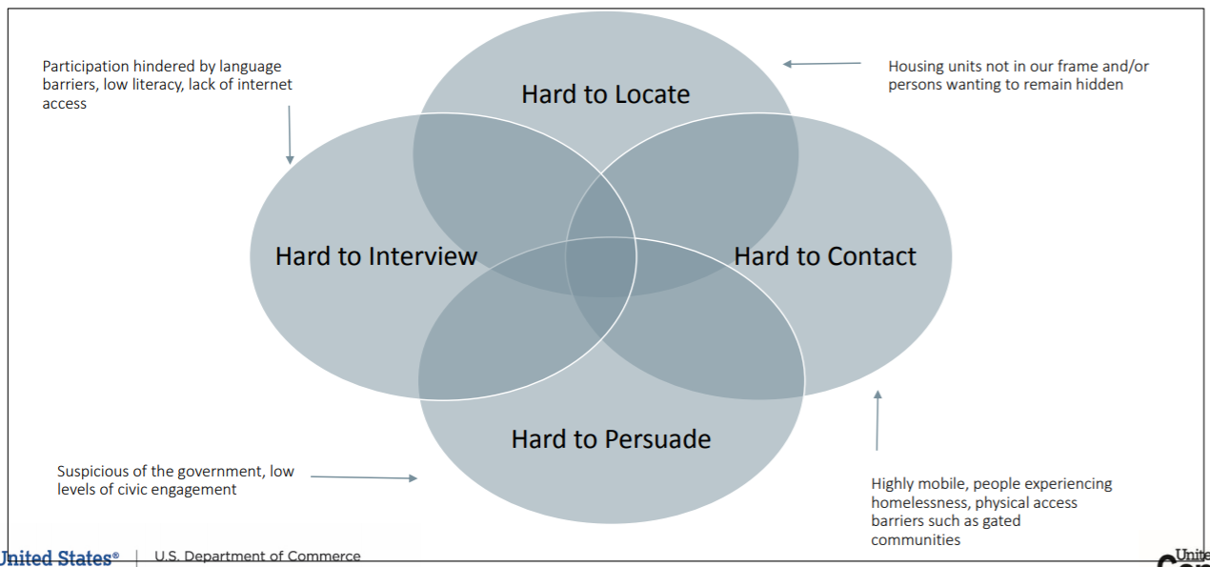
Who is at risk of being undercounted?

Slide 6
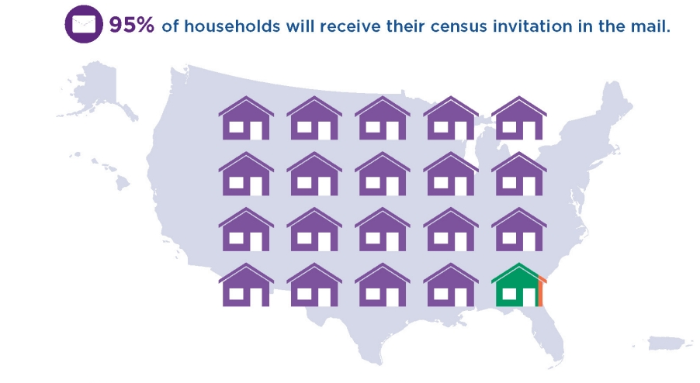
How will the 2020 Census Work?
March 12 – mailing to every household
New option to respond online
Other methods for group living situations
Household visits in remote and rural areas
April 1 – “Census Day”

Slide 7
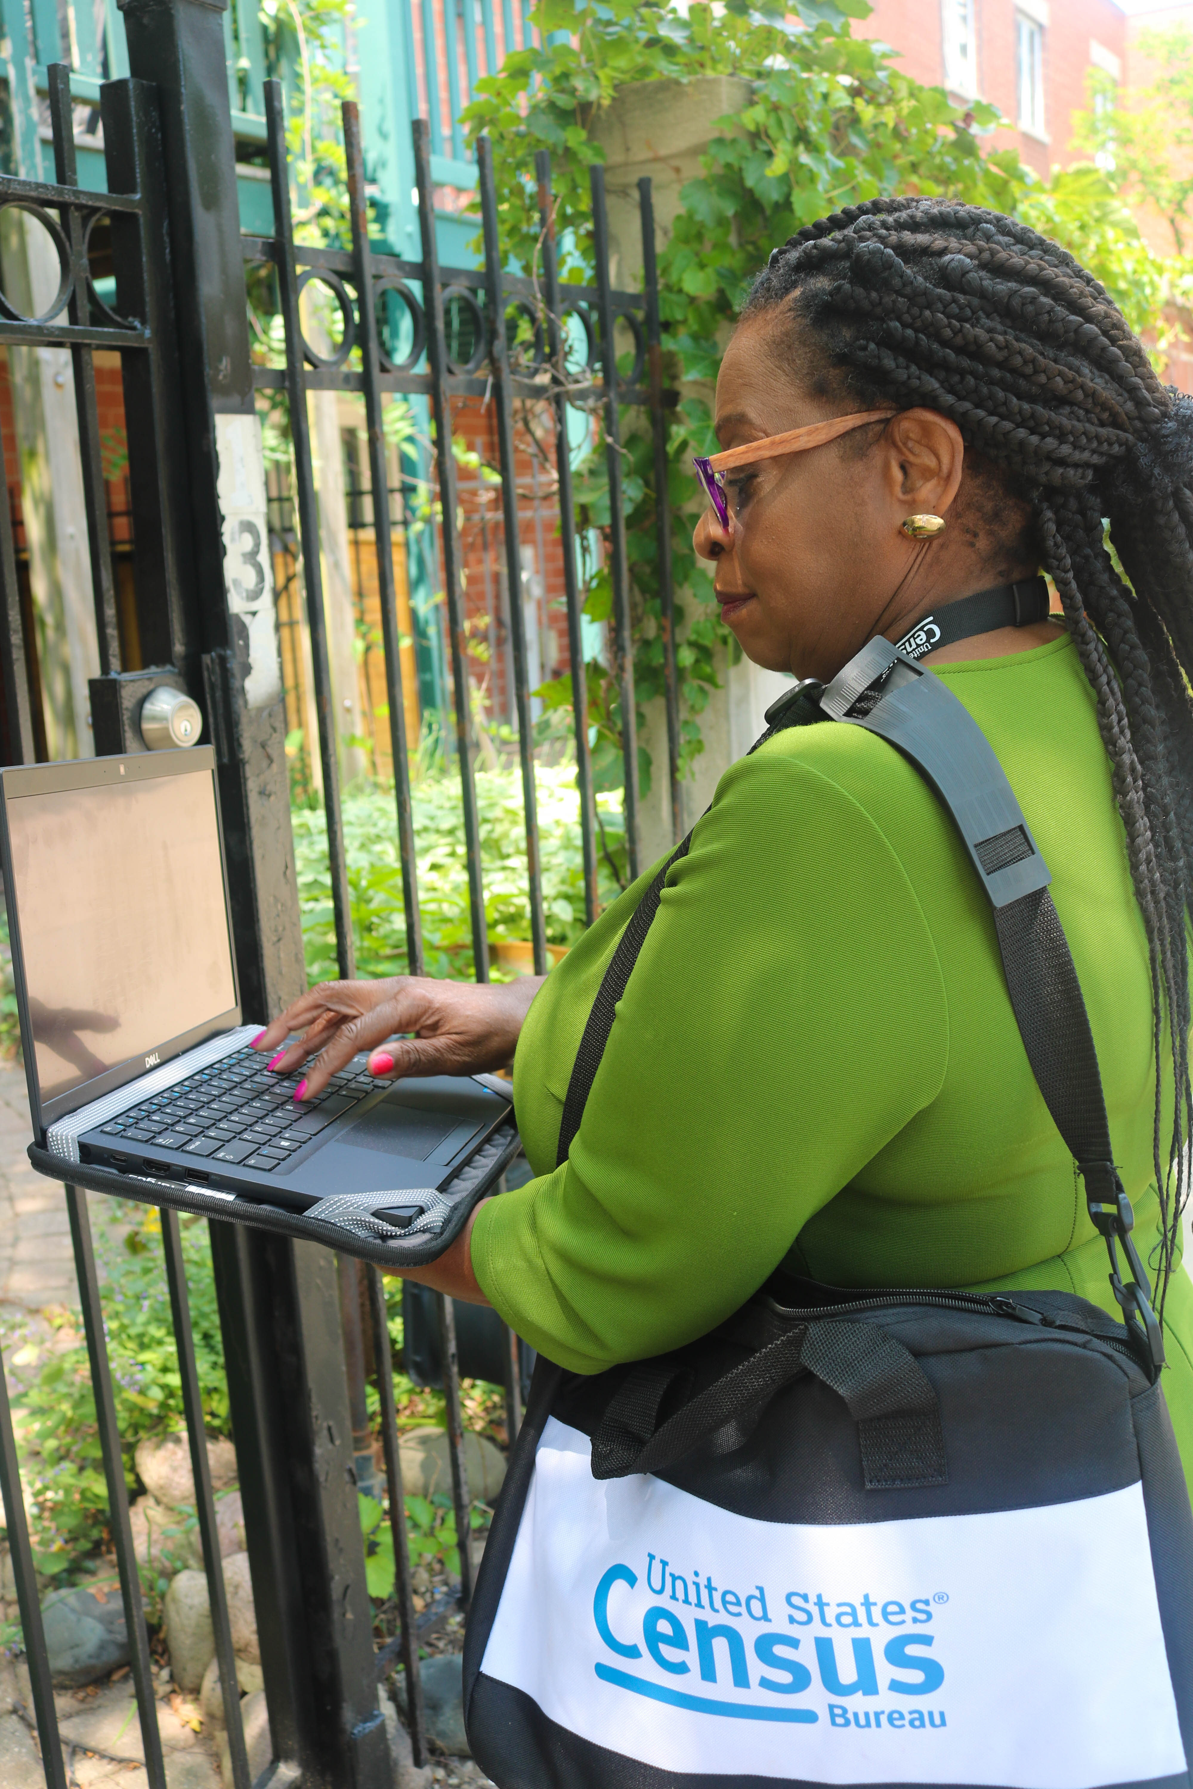
How will the 2020 Census Work?
April – Group quarters counted
May – In-person visits to households that haven’t responded
Paper questionnaire sent to households that haven’t responded
In-person follow-up, if needed

Slide 8
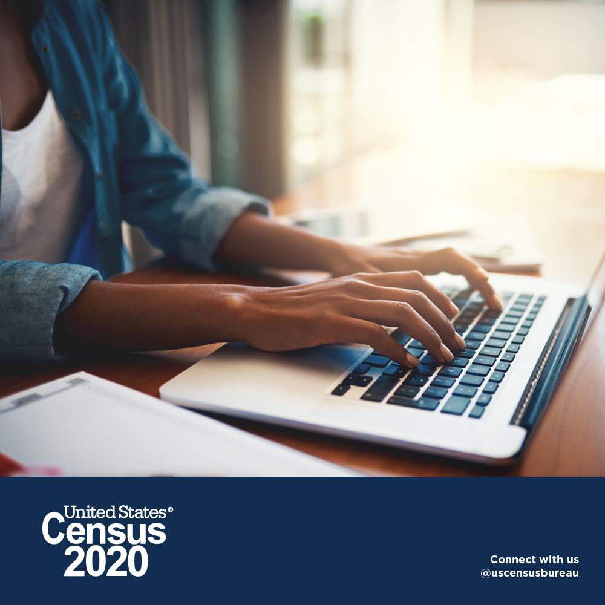
How will the Census work?
Online, by phone, or by mail
Online – smartphone, tablet, or computer
Online – secure and responses encrypted
Online & phone – questionnaire available in 13 languages
About 10 minutes to complete questionnaire
Toll-free Census Bureau phone hotline in 13 languages

Slide 9
How can people respond to the 2020 Census?
Efforts to reach hard-to-count communities
Online and phone questionnaire available in 13 languages
Guides in 59 non-English languages
Census Bureau plans to hire employees who are
familiar with neighborhoods
reflect diversity of communities
Census Bureau will partner with “trusted voices” – such as libraries

Slide 10
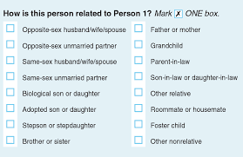
What is new in the 2020 Census?
Online self-response
Household relationship question
No citizenship question
Census responses are confidential.

Slide 11
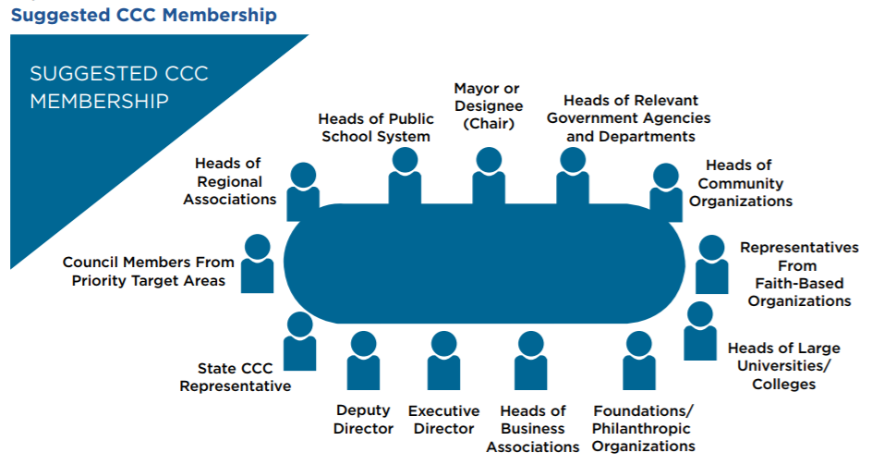
What can libraries do? How can libraries prepare?
Participate in Complete Count Committees
Local communities establish
To increase awareness
To encourage residents to respond to 2020 Census
https://www.census.gov/library/visualizations/interactive/2020-complete-count-committees.html

Slide 12
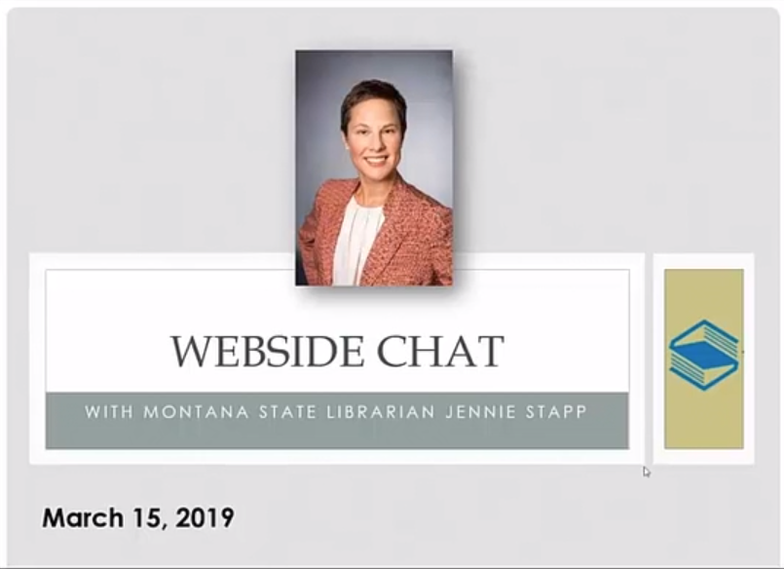
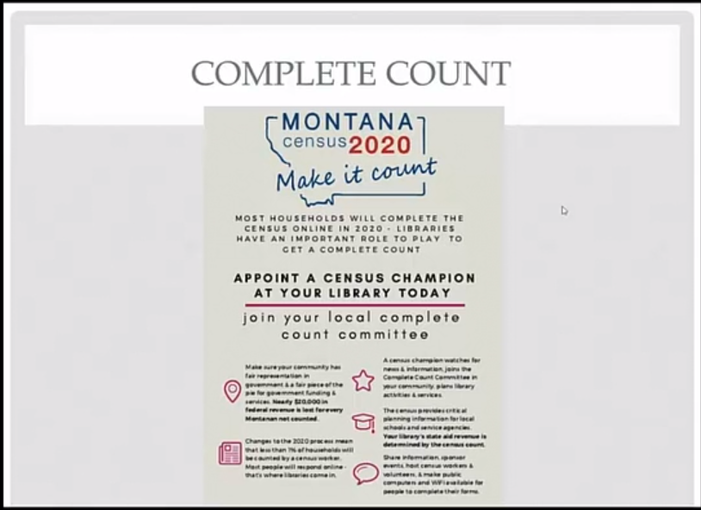
What can libraries do? How can libraries prepare?
Participate on Complete Count Committees
Montana State Librarian Jennie Stapp is a
Montana State Complete Count Committee member.

Slide 13
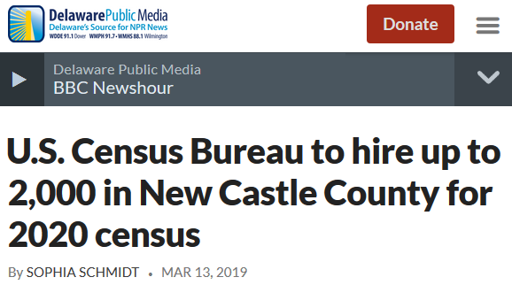
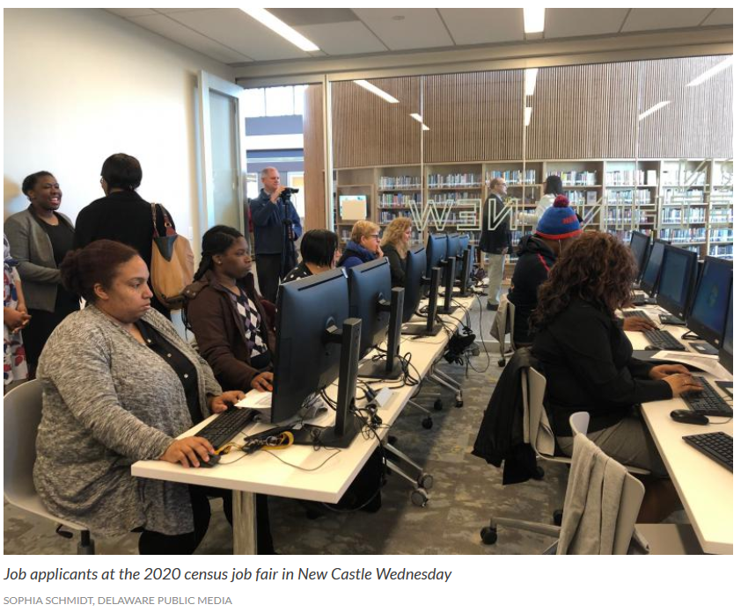
What can libraries do? How can libraries prepare?
Prepare for increased use of computers and the Internet
2020 census will encourage online response
March and April 2020 – Many people may come to libraries to complete census form online.
Census Bureau job hiring requires online application

Slide 14
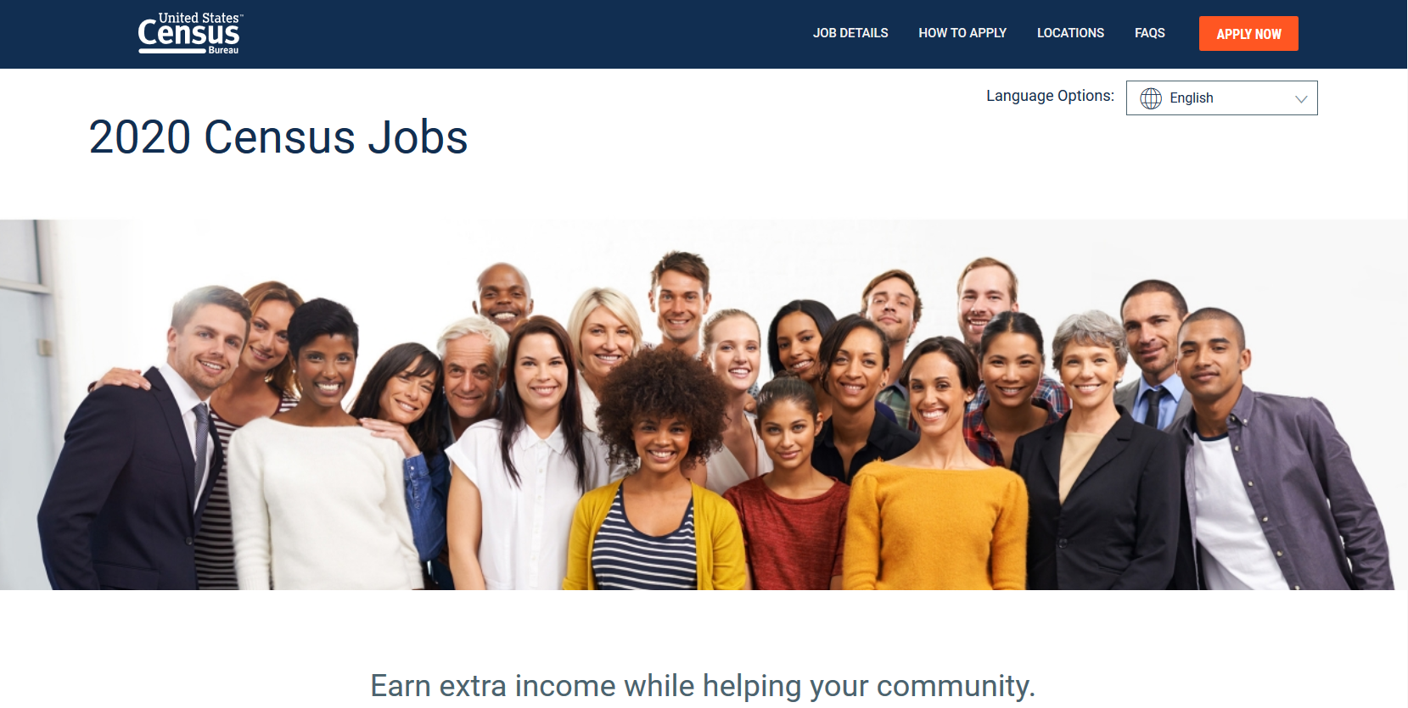
What can libraries do? How can libraries prepare?
Help community members apply for census jobs
Census Bureau will hire about 500,000 temporary workers
Jobseekers must apply online
Apply online at 2020census.gov/jobs

Slide 15

What can libraries do? How can libraries prepare?
Help community members apply for census jobs
Spread the word – newsletters, social media
Host job fairs with Census Bureau
For a local contact: 1-855-JOB-2020 and press 3
to reach your area census office

Slide 16
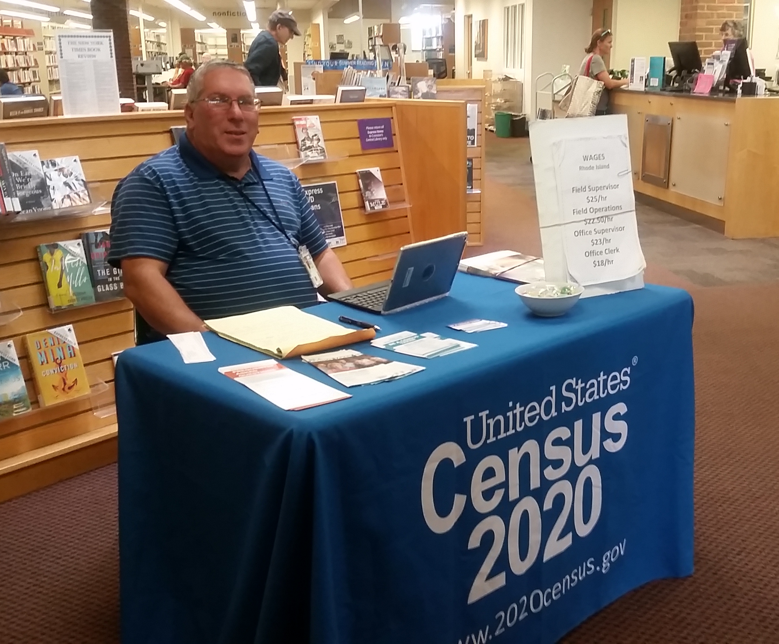
What can libraries do? How can libraries prepare?
Help community members apply for census jobs
Cranston Public Library (RI) hosting 8 Census job fairs currently – and hosted over 75 Census job fairs and trainings during the 2018 test.

Slide 17
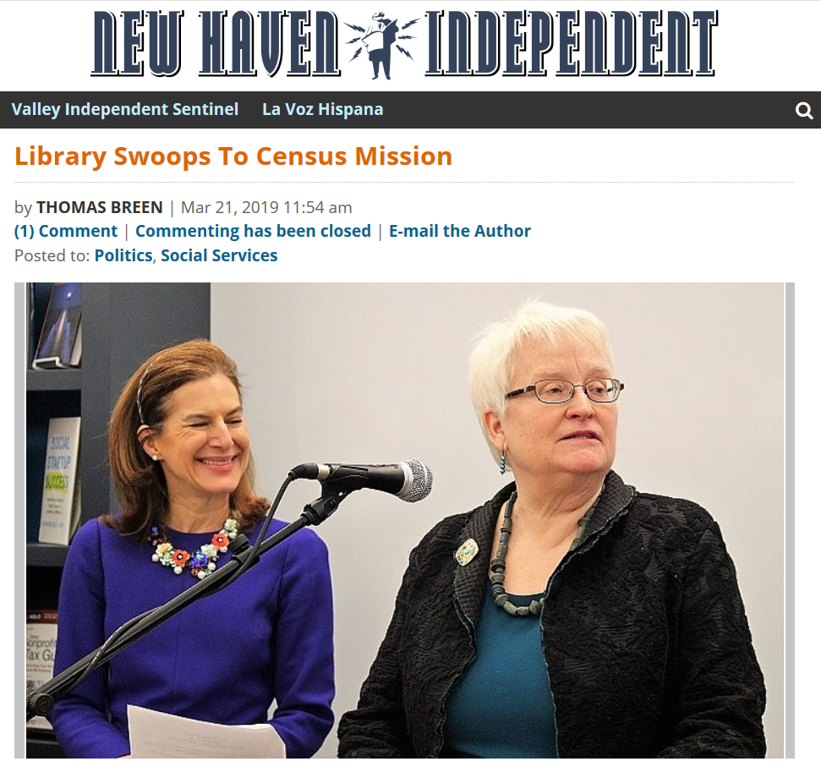
What can libraries do? How can libraries prepare?
Help community members apply for census jobs
New Haven (CT) Free Public Library “hosted five census job fairs that saw 160 New Haveners come by to learn more and apply.”

Slide 18
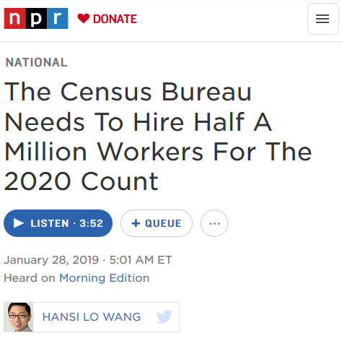
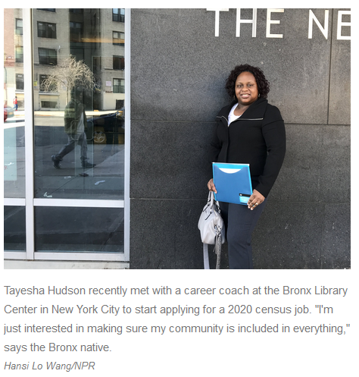
What can libraries do? How can libraries prepare?
Help community members apply for census jobs

Slide 19
What can libraries do? How can libraries prepare?
Share information about the 2020 Census.
The more people know about the census,
how the data are used,
and how it impacts them and their communities,
the more likely they are to participate.

Slide 20
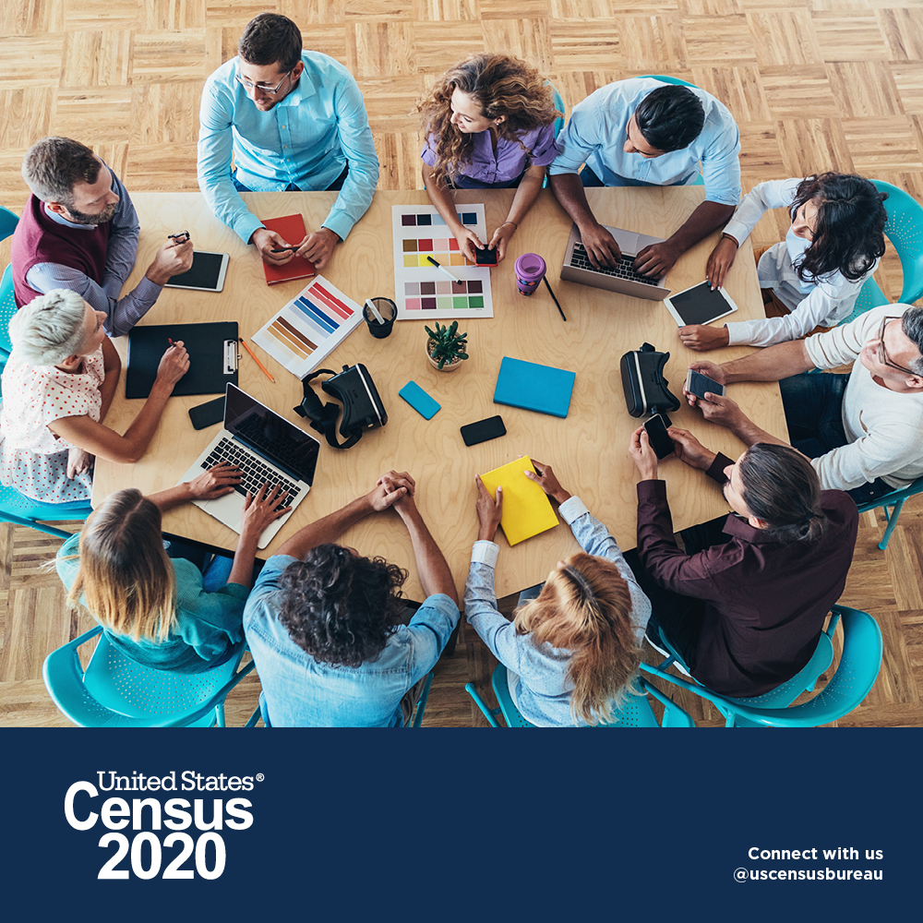
What can libraries do? How can libraries prepare?
Share information about the 2020 Census.
Host programs and events to increase awareness of the upcoming census
Highlight the census in newsletters, social media, and on website

Slide 21
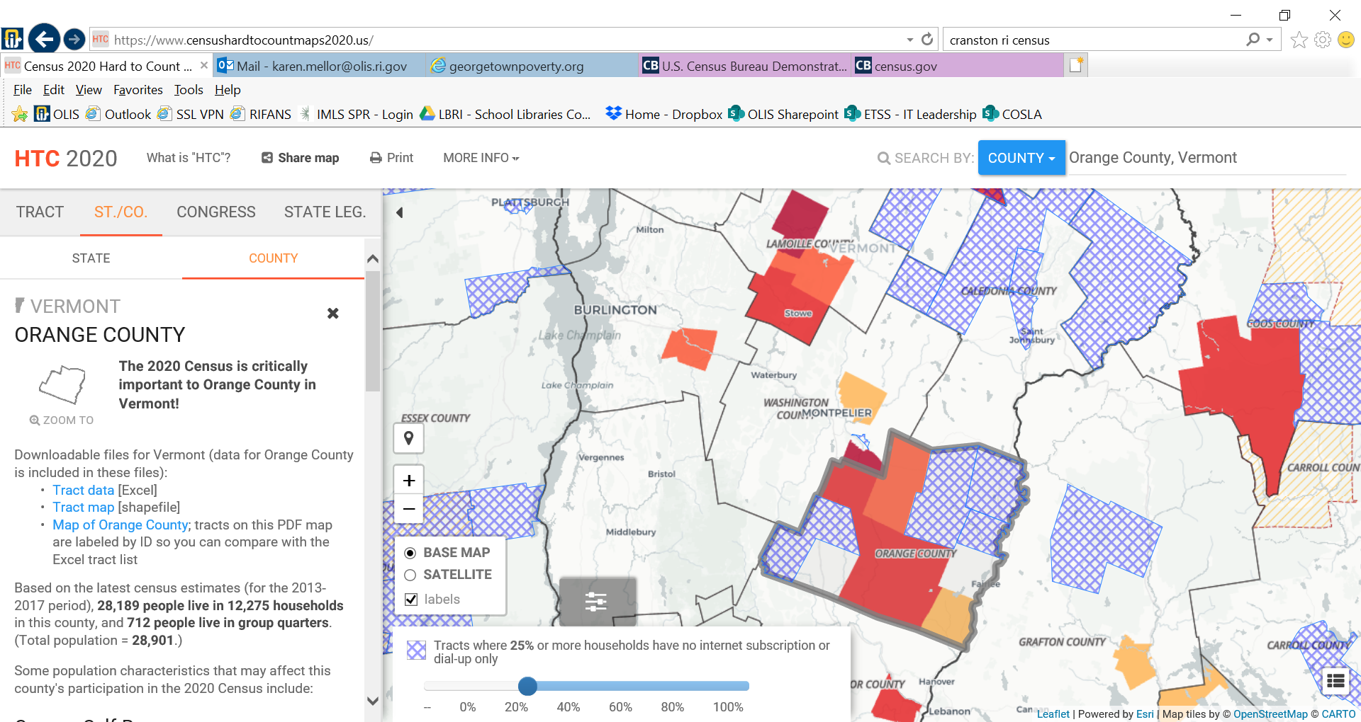
What can libraries do? How can libraries prepare?
Share information about the 2020 Census.
Reach out to
hard-to-count populations.
censushardtocountmaps2020.us

Slide 22
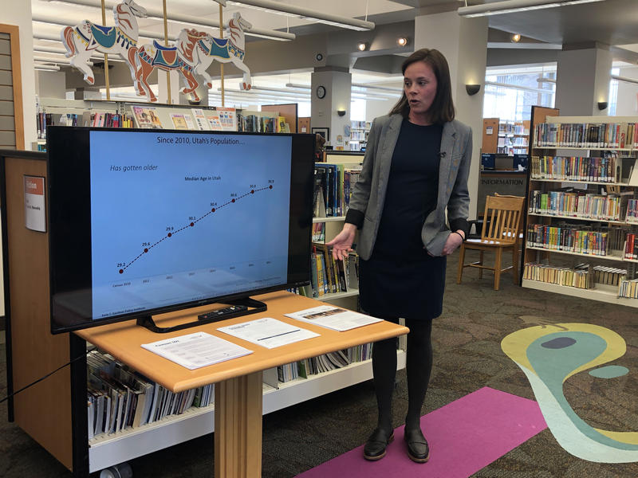
What can libraries do? How can libraries prepare?
Share information about the 2020 Census.
Salt Lake County, Columbus Library (UT)
Source: https://www.kuer.org/post/utah-preparing-2020-census-which-may-include-controversial-citizenship-question#stream/0

Slide 23
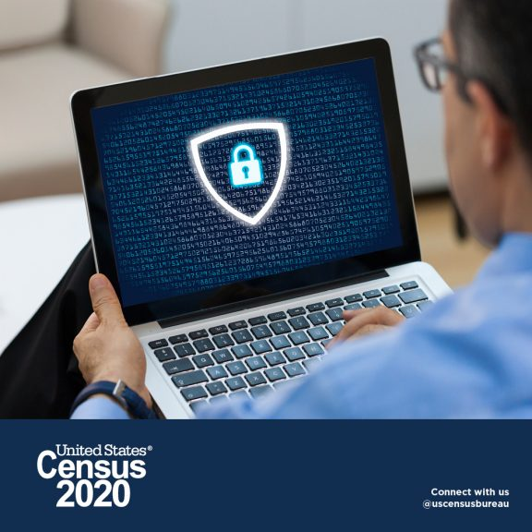
What can libraries do? How can libraries prepare?
Fight misinformation, disinformation, and scams.
People may have questions and concerns
Libraries can provide accurate information
[image

Slide 24
Learn More
ALA: ala.org/census
Census Bureau: 2020census.gov
Census Bureau regional offices

