Slide 1

2017-2018 ALA CD #13.2
2017-2018 Annual Conference
Treasurer’s Report at the Information Session
to the ALA Executive Board, ALA Council and
the Planning and Budget Assembly
Susan Hildreth – ALA Treasurer
Saturday – June 23, 2018
Sunday – June 24, 2018
Annual Conference – New Orleans LA

Slide 2
Sources of ALA Revenue
16% Dues | 26% Meetings & Conferences | 34% Publishing | 10% Grants | 3% Interest | 11% Other
Based on the approved 2018 budget
Notes:
The ALA Dollar, based on 2018 budget, updated annually and is on Treasurer’s page
Illustrates how we pay for the many things we do as an Association
Note that publishing and meetings and conferences are primary sources of income
Thanks for your support of the dues increase. The increase will be useful in keeping up with rising costs and supporting key initiatives but at 17% of overall revenue, dues income cannot support all the activities of the association.

Slide 3
Where Does Your ALA Dollar Go?
14% Advocacy | 10% Equity, Diversity and Inclusion | 10% Information Policy and Intellectual Freedom | 41% Professional and Leadership Development | 25% Member Services and Support
Based on the approved 2018 budget
Notes:
This graphic clearly shows how your ALA dues dollar is spent and is determined by ALA’s Mission and Strategic Directions. Based on 2018 budget, updated annually and is on Treasurer’s page
Includes activities of the Washington Office, the Office of Intellectual Freedom, the Office of Diversity, Literacy and Outreach Services as well as general Member Support
Activities in these areas overlap, professional development may intersect with equity but we have allocated major expenses as clearly as possible

Slide 4
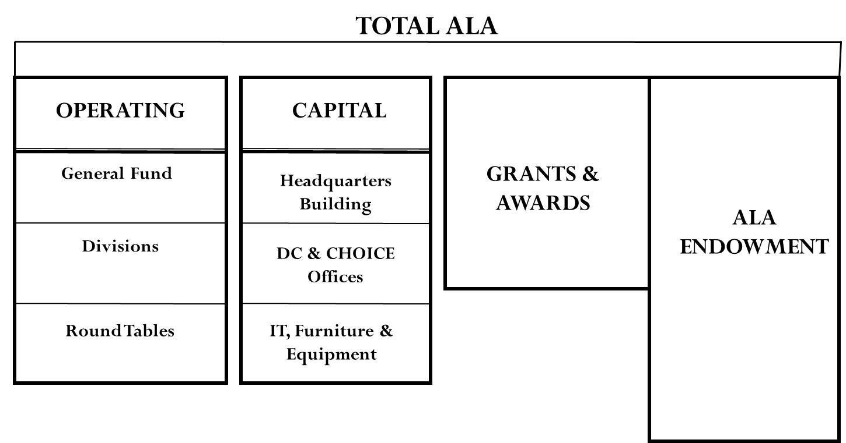
ALA Operating Structure
CAPITAL PROJECTS
Notes:
- Depiction of we structure our budget, by “funds”
- ALA’s Operating budget are the primary focus of organization and include general fund, divisions and round tables
- ALA’s Capital budget includes our physical facilities in Chicago and DC as well as our IT systems
- ALA’s Grant budget includes mission related grant activities for ALA as a whole as well as the Divisions
- ALA’s Endowment includes ions but the organization primarily relies on the interest generated by these investments

Slide 5
A Modern Association for a Modern Profession
It Begins with the FY19 Budget
Notes:
Articulate theme coined by Maggie Farrell, BARC member

Slide 6
ALA General Fund Net Revenues (Expenses)
Budget reflects targeted investments in Advocacy, ITTS and Development
Neal Schuman Acquisition
*FY18 Management Projection
Source: ALA Audited Financial Statements
Notes:
ALA General Fund Net Revenues (Expenses)
2010 2011 2012 2013 2014 2015 2016 2017 2018* 2019
$(8,027) $(437,067) $(1,372,230) $76,787 $906,587 $279,375 $(1,067,553) $(1,693,796) $77,470 $(1,715,043)
You can see a somewhat alarming pattern here. As a result of the recession and Neal Schuman acquisition we had net expenses in 2010-2012. We saw some recovery in 2013-2015 but have had difficult years recently with net expenses of about $1M in 2016 and $1.7M in 2017. We hope to end FY 2018 in the black – actual outcome will depend on annual conference revenues and expenses. In FY 2019 we are planning investments which will require us to use net assets but we are allocating resources strategically to develop the association in contrast to ending up in a deficit without anticipating how to address it.
*FY18 Year End projection
FY19 Proposed budget

Slide 7
FY 2019 Preliminary Budget
To Be Presented to Council at this Annual Conference
in New Orleans
Notes:
Budget will be present to Council at the Council II session on Monday, June 25.

Slide 8
FY19 Preliminary Budget Details
(The Numbers Behind Our Plan for FY19)
$46.7M
$28.4M
$3.9M
$13.4M
$.6M
CAPITAL PROJECTS
$TBD
$0.4M
General Fund FY19 Revenue Budget of $28.4M
General Fund FY19 Expense Budget of $30.1M
Budgeted FY19 Net Expense of ($1.7 M)
Support from Net Assets of $1.7 M
General Fund Net Revenue of $0
8
Notes:
Here is the preliminary picture for the FY 19 budget. This budget is subject to revisions based on the FY 18 fourth quarter revenue and expenses and any other critical factors.
The General Fund budget reflects planned strategic investments that will both improve the overall Association’s financial prospects as well as attain mission.
Investment budget of $1.7M in general fund supported by use of net assets.
Grants and awards are projected based on grants in hand as well as grants anticipated.
Division are using $2.2M of their net assets to invest in membership, strategic initiatives, capacity building for new programs and new revenue streams

Slide 9
Key Supplemental Investment Areas in FY19
Development - $177,000
Advocacy - $410,000
Information Technology- $1.36M

Slide 10
Key Supplemental Investment Areas in FY19
Development ($177K)
Enhance fundraising capacity
  Reallocate existing staff positions to support 2.5 additional FTE
  Major gifts director, prospect researcher and support
Benefits to the Association
Will increase staff capacity resulting in stronger donor engagement
Will result in additional donor dollars
More effective donor stewardship through CRM (customer relationship management) system will lead to more successful fundraising

Slide 11
Key Supplemental Investment Areas in FY19
Advocacy ($410K)
Support 21st century advocacy efforts
  CRM (customer relationship management) system for advocacy information
  Support for enhanced outreach and engagement
Benefits to the Association
Provides more strategic focus on policy issues and targeted outreach
Supports a year-round strategy for Advocacy, with enhanced capacity for mobilization efforts and campaigns
Initiates a “Fly-In” event early in budget season for strategic legislative contacts to jump-start annual budget campaign
Revitalizes National Legislative Day
Creates more impactful legislative advocates, both key local players and broader grassroots networks

Slide 12
Key Supplemental Investment Areas in FY19
Information Technology ($1.36M)
Investment will strengthen IT infrastructure and services
  First year of three-year planned investment for capacity and customer service
Benefits to the Association
Will improve experience of the 8 million+ annual visitors to ALA’s web site
Enhanced opportunities for members and staff to working more efficiently and collaboratively, for a more effective Association
Will provide the profession with the ability to quickly coordinate advocacy campaigns, reach out to funders/policy makers and initiate policy initiatives
Dashboard will improve reporting capabilities, save staff time and inform more effective decision making

Slide 13
How Do We Support These Investments?
Funding Options and Strategies Available to Use
    Working Capital (ALA Cash)
    Bank Financing
    Leveraging ALA Real Estate
    Using the Association’s Net Assets
    Endowment Fund
Notes:
Manage cash carefully
Bank financing can be used for capital expenses, including some IT, not operating
Reviewing possibilities of leveraging ALA real estate assets
Using other assets of Association, including ALA endowment

Slide 14
ALA’s Balance Sheet as of FYE 2017
ASSETS = LIABILITIES + NET ASSETS
ASSETS
“What We Have”
Cash
Accounts Receivable
Inventory
Investments
Land
NET ASSETS
$39.9M
(55% of Assets)
$72.5M
LIABILITIES
“What We Owe”
Accounts Payable
Payroll
Debt
Post-Retirement Benefits
$32.6M
(45% of Assets)
Net Assets is the difference between what we have and what we owe
Notes:
Let’s talk about net assets.This represents ALA’s audited balance sheet at the end of FY 17 or August 2017. It is recalculated at the end of each fiscal year with the annual audit so will be revised in fall 2018.
ALA has a strong balance sheet
The equation for the Statement of Financial Position or Balance Sheet is:
Net Assets = Assets – Liabilities
On left – what we have: $72.5M
Assets = Cash, Investments/Endowment, Real Estate, Inventory etc.
On lower right - what we owe $32.6 M 45%
Liabilities = Payroll, Accounts Payable, Bank Debt, Post retirement Obligation
On upper right – what we have when all liabilities are paid - $39.9 M 55%

Slide 15
A Need to Transition
- Keeping with Policy -
Budgetary Ceiling Components
Unexpended Net Assets for the Divisions and Roundtables
+ Budgeted revenues for the upcoming fiscal year for the
  - General Fund
  - Divisions
  - Roundtables
  - Grants & Awards
  - Long-Term Investments
= Budgetary Ceiling
Annual Estimates of Income Components
Unexpended net assets for total ALA
+ Budgeted revenues for the upcoming fiscal year for the
  - General Fund
  - Divisions
  - Roundtables
  - Grants & Awards
  - Long-Term Investments
= Annual Estimates of Income
Notes:
As we developed the FY 19 budget we realized that the budgetary ceiling approach would not work. In past budgets, the general fund was always balanced, even though that protocol may have limited the capacity of the association to move forward.
Only the division and roundtable net assets were included in the budgetary ceiling calculation. For FY 19 we are also including the General Fund net assets to develop the annual estimate of income. The development of the budgetary ceiling was a practice that has been in place for a number of years but was not defined in any fiscal policy.
Here are specific examples.

Slide 16
ALA Fiscal Year 2019 Budgetary Ceiling
As part of ALA's annual budget process, a budgetary ceiling is calculated and presented to the Budget Analysis and Review Committee (BARC) for approval. The budgetary ceiling document captures and presents all available resources, or sources of funds, that can be expended during the subsequent fiscal year. Sources include a starting amount represented by any accumulated Net Asset Balances, where applicable, built up over previous fiscal years. Additionally, these Net Asset balances are supplemented by budgeted revenues as well as any inter-fund transfers. The total of these sources represents the ceiling, or maximum available resources from all sources. BARC is charged with reviewing and approving the individual fund ceilings and Total All Funds ceiling presented in the bottom row below.
Notes:
For those of you who have been on Council previously you may have seen this presentation of the budgetary ceiling. I know this print is small but the important factor to note is that only the net assets of the divisions and roundtables were represented here. Using the budgetary ceiling protocol, the FY 19 budgetary ceiling is $61.7M. The budgetary is more that the total operating budget – it is the amount beyond which the association cannot incur expenses.

Slide 17
ALA Fiscal Year 2019 Annual Estimates of Income
Per Article IX, Finances, Section 1 of ALA's Bylaws: Annual estimates of income shall be based upon the unexpended balance remaining from the previous year plus anticipated revenues for the next budget year. BARC is charged with reviewing and approving the Annual Estimates of Income.
Annual Estimate of Income |  | Total ALA
ALA Net Assets (projected at end of FY 2018) |  | $ 37,643,998
FY 2019 Budgeted Revenues
General Fund |  | 28,353,253
Divisions |  | 13,426,560
Roundtables |  | 398,284
Grants & Awards |  | 3,907,243
Endowment |  | 575,296
Total |  | 46,660,636
FY 2019 Annual Estimates of Income |  | $ 84,304,634
Memo Only
Estimates of Income by Fund
 | Divisions | Round Tables
Available Net Asset Balance (projected at end of FY 2018) | $ 13,263,800 | $ 1,895,316
FY 2019 Budgeted Revenues | 13,426,560 | 398,284
FY 2019 Annual Estimates of Income | $ 26,690,360 | $ 2,293,600
Notes:
The annual estimate of income represents the net assets of the association as a whole and the estimated revenue for FY 19. The annual estimate of income is defined in ALA bylaws as the net assets of the association plus the anticipated revenue for the upcoming fiscal year. The annual estimate for FY 19 is $84.3 M, which is $22.6 M more than the budgetary ceiling.
The annual estimate of income provides a more complete financial picture of the association than the budgetary ceiling. In any case, the annual estimate represents how much money the association could spend. It is far beyond what will be spent in FY 19 based on the revenue estimate of $46.6 M
You will be asked on Monday at Council II to approve the annual estimate of income of $84.3M.

Slide 18
Will Request
Council Approval
FY19 Annual Estimates of Income of
$84,304,634

