Slide 1
Treasurer’s Report to Council
2016-17 ALA CD #13.3
2017 Annual Conference
Fiscal Year 2018
- Annual Estimates of Income and Budgetary Ceiling -
Susan Hildreth – ALA Treasurer
Tuesday, June 27, 2017
Chicago, IL

Slide 2
FY 2018 Preliminary Budget
Reviewed by BARC and
the Executive Board at their
2017 Spring Meetings

Slide 3
ALA Programmatic Priorities – Aligned with the FY 2018 Budget
Literacy
Organizational Excellence
Intellectual Freedom
Transforming Libraries
Advocacy for Libraries and the Profession
Diversity
Equitable Access to Information and Library Services
Education and Lifelong Learning
3

Slide 4
Strategic Directions - Strategic Framework aligned with FY 2018 Budget
Equity, Diversity and Inclusion
The ALA recognizes that equity, diversity and inclusion impacts all aspects of work among members of the Association, the field of librarianship, and the communities served by libraries.
Information Policy –
Focus at every level on a diverse set of policy areas that includes:
intellectual freedom
privacy
civil liberties
telecommunications
funding for education and research programs
funding for libraries
copyright and licensing
government information
literacy
Advocacy
Advocate for the public value of librarians, libraries and information services
Professional and Leadership Development
Promote the professional and leadership development of librarians and library workers which is essential to high-quality professional practice and the future of libraries and information services
4

Slide 5
Enabling Strategies
Assessments and Evaluations
Governance and Committee Structure
Staffing
Communications, PR and Marketing
Revenue Streams and Fundraising
Division Engagement
Technology Infrastructure
Publishing and Conferences
Member Involvement and Engagement
Partnerships
Strategies have also been identified for ALA to undertake in order to create a welcoming, inclusive, engaged and supportive organization that is focused on the four Strategic Directions

Slide 6
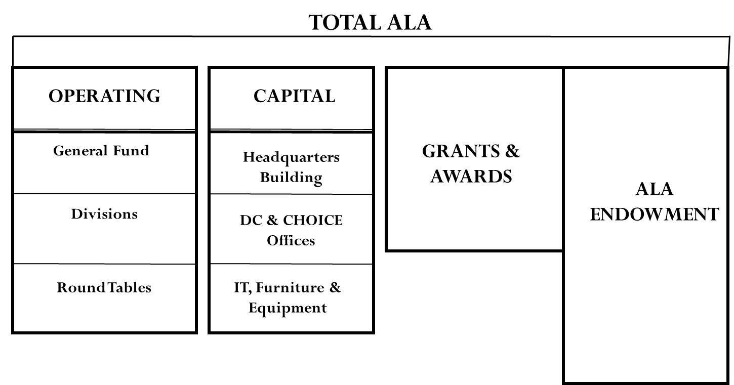
FY 2018 Preliminary Budget Details (The Numbers Behind Our Plan for FY 2018)
$51.5M
$29.7M
$4.6M
$15.8M
$1.1M
CAPITAL PROJECTS
$1.8M
$0.4M
Total ALA FY18 Revenue Budget of $51.5M
Total ALA FY18 Expense Budget of $52.3M
Budgeted FY18 Net Expense of $753k
6
6
Notes:
Here is the preliminary picture for the FY 18 budget. This budget will be reviewed at the Annual Conference and is subject to revisions based on FY 17 fourth quarter revenue and expenses and any other critical factors.
This is a year in which ALA is projecting a deficit of $753k out of a $51.5M budget, or 1.5% of total budget which is quite small.
Grants and awards are projected based on grants in hand as well as grants anticipated.
A key goal for FY 18 is for the General Fund to meet or exceed its budget. A thorough review of publishing activities will occur to try to insure that revenue estimates are realistic.
Division are using $1M of their own assets to invest in membership, strategic initiatives, capacity building for new programs and new revenue streams

Slide 7
FY2018 Budget Operating Highlights
Total operating revenues of $51,534,210 (up 3.0% from FY17)
Total operating expenses of $52,287,161 (up 0.8% from FY17)
General Fund operating revenues of $29,721,427 (up 0.5% from FY17)
General Fund operating expenses of $29,685,055 (up 0.6% from FY17)
7
Notes:
Key talking points

Slide 8
FY2018 Budget Operating Highlights
General Fund revenues/expenses are flat from last year at $29.7 million
A 2% compensation increase for staff, along with an additional organization incentive as a top priority for any positive year-end results
An increase in Publishing revenue of $436,000 based on the release of the new AASL standards
Over $1.0 million in Division investment in membership, strategic priorities, capacity and revenue building
Increases in the budgets for ODLOS, OIF, HRDR, OLA and the Center for the Future of Libraries to support the ALA strategic directions
8
Notes:
Key talking points
Total ALA FY18 budget is $51.5M, which is a 3.0% increase from the FY17 Total ALA budget
Total ALA FY18 expenses are $52.3M, which is 0.8% higher than last year reflecting the investment by ACRL in revenue generating ideas

Slide 9
FY2018 Budget Operating Highlights
(Con’t)
An increase of donations resulting in $150,000 being allocated for use as one-time initiatives that advance ALA’s Strategic Directions
$108,500 in additional investment income for ITTS’ capital expenditures to enhance Technology Infrastructure – fully-functioning e-store, “Next Gen” online learning site, ALA Connect enhancement
PLA (Philadelphia) and AASL (Phoenix) will hold national conferences
Midwinter Meeting in Denver, CO
Annual Conference in New Orleans, LA
9
Notes:
Key talking points

Slide 10
Total ALA Fiscal Year 2018 Budgetary Ceiling
Net Assets
(Unexpended balance remaining from FY 2017)
+
Revenue
(Anticipated for FY 2018)
=
Budgetary Ceiling
Notes:
At the Spring Board meeting in April, member leaders consisting of BARC, F&A, the Executive Board, and myself reviewed and approved the proposed FY18 Budgetary Ceiling
Budgetary Ceiling represents the total funding available for the Association to pursue its key initiatives and support ongoing operations

Slide 11
Total ALA FY 2018 Budgetary Ceilings
General Fund
Divisions
Round Tables
Grants & Awards
Long-Term Investments
Total
$29,792,027
28,875,232
2,206,967
4,551,555
1,249,209
$66,674,990
Notes:
For FY18, the total requested ALA budgetary ceiling is $66,674,990
This represents a decrease of (-0.1%) from FY17 ($66,747,279)

Slide 12
General Fund Annual Estimate of Income
Budgeted FY 2018 Revenues
Dues
Material Sales
Subscriptions
Advertising
Meetings & Conferences
Miscellaneous
Total Budgetary Ceiling (2018)
$5,543,600
5,821,791
2,979,089
4,527,597
7,950,875
2,969,075
$29,792,027
Notes:
Of the 4 financial “funds” that make up the Total ALA budget, the General Fund is the largest
The FY18 budget of $29.8M represents a (0.7%) increase from FY17 ($29,587,223)

Slide 13
Divisions Annual Estimate of Income
Estimated Beginning -
Net Asset Balance (Ending FY17 Projection)
Budgeted FY 2018 Revenue
Other Revenue Transfers*
Total Budgetary Ceiling (2018)
$ 13,116,128
15,743,879
15,225
$28,875,232
*Life and Continuing Member Dues
Notes:
The second largest fund contains Division related activities and operations
For FY18, total available budget is $28M, which flat (0.6%) from FY17 ($28,702,106).
Unlike the General Fund, Divisions are able to use net assets ($13.1 M if available) to fund key initiatives and investments.

Slide 14
Round Tables Annual Estimate of Income
Estimated Beginning -
Net Asset Balance (Ending FY17 Projection)
Budgeted FY 2018 Revenue
Total Budgetary Ceiling (2018)
$1,789,877
417,090
$2,206,967
Notes:
For FY18, approved funding for the 20 ALA Roundtables is $2.2 million, which is a -0.2% decrease from FY17
Like the Divisions, Roundtables can also use available net assets for key initiatives.

Slide 15
Grants and Awards Annual Estimate of Income
Non-Government
Government
Contributions
Total Budgetary Ceiling (2018)
$2,319,501
1,944,007
288,047
$4,551,555
Notes:
An increasingly important contributor to ALA’s mission, Grant funded initiatives will total $4.5M, which is an (-15.6%) decrease from FY17

Slide 16
Long-Term Investment Annual Estimate of Income
Budgeted FY 2018 Revenue
Budgeted FY 2018 Revenue & Transfers
Interest/Dividend Transfer to GF
Spectrum Interest/Dividends
Life Member Dues
Total LT Investment Distribution
Total Budgetary Ceiling (2018)
$1,702,429
$(588,583)
$221,188
$(85,825)
($453,220)
$1,249,209
Notes:
The fourth and final fund in the Total ALA budget is the Long Term Investment fund, also known as the ALA Endowment.
In FY18, total projected revenues from the Endowment are $1.2M, which is a (-47.4%) change from FY17 ($847,358),
A total of $674,408 is transferred to the Divisions and the General Fund to support operations and life member dues
$221k is used to fund Spectrum scholarships

Slide 17
REQUEST OF COUNCIL
Approval of Fiscal Year 2018
Budgetary Ceiling of
$66,674,990

Slide 18
Mark Your Ballot
FY18 Budgetary Ceiling

Slide 19
Thank You

