Slide 1
Council Financial Orientation
- The ALA Budget and Decision Making Process -
Susan Hildreth – ALA Treasurer
Saturday - June, 23 2018
New Orleans, LA
Notes:
Let me welcome you to the Council’s finance orientation on the ALA budget development process.
This orientation is more detailed than in previous years. Councilors had a number of financial questions at the MidWinter meeting in Denver. We thought it would be helpful to go into more detail in this presentation and have time for questions. We invited division and roundtable fiscal officers and all councilors to the session. I hope this is useful for all. Although I want to cover all the topics, I think it would be useful for you to pose questions during the presentation if there is something that is not clear. We will also have time for questions at the end of the presentation.

Slide 2
The Process Starts and
Ends with Your Actions
At Each Midwinter Meeting
At Each Annual Conference
Council approves the Association’s Programmatic Priorities and Strategic Directions
Council approves the Annual Estimates of Income
Notes:
2 major budget actions that Council takes
For those who have served on Council previously, in the past you were asked to approve the annual budgetary ceiling. This year we will ask you to approve the Annual Estimates of Income and we will touch on that in more detail later in the presentation.

Slide 3
Sources of ALA Revenue
16% Dues | 26% Meetings & Conferences | 34% Publishing | 10% Grants | 3% Interest | 11% Other
Based on the approved 2018 budget
Notes:
The ALA Dollar, based on 2018 budget, updated annually and is on Treasurer’s page
Illustrates how we pay for the many things we do as an Association
Note that publishing and meetings and conferences are primary sources of income
Thanks for your support of the dues increase. The increase will be useful in keeping up with rising costs and supporting key initiatives but at 17% of overall revenue, dues income cannot support all the activities of the association.
Other is primarily royaltie ($1.8M) and misc fees- total is about $3M

Slide 4
Where Does Your ALA Dollar Go?
14% Advocacy | 10% Equity, Diversity and Inclusion | 10% Information Policy and Intellectual Freedom | 41% Professional and Leadership Development | 25% Member Services and Support
Based on the approved 2018 budget
Notes:
This graphic clearly shows how your ALA dues dollar is spent and is determined by ALA’s Mission and Strategic Directions. Based on 2018 budget, updated annually and is on Treasurer’s page
Includes activities of the Washington Office, the Office of Intellectual Freedom, the Office of Diversity, Literacy and Outreach Services as well as general Member Support
Activities in these areas overlap, professional development may intersect with equity but we have allocated major expenses as clearly as possible

Slide 5
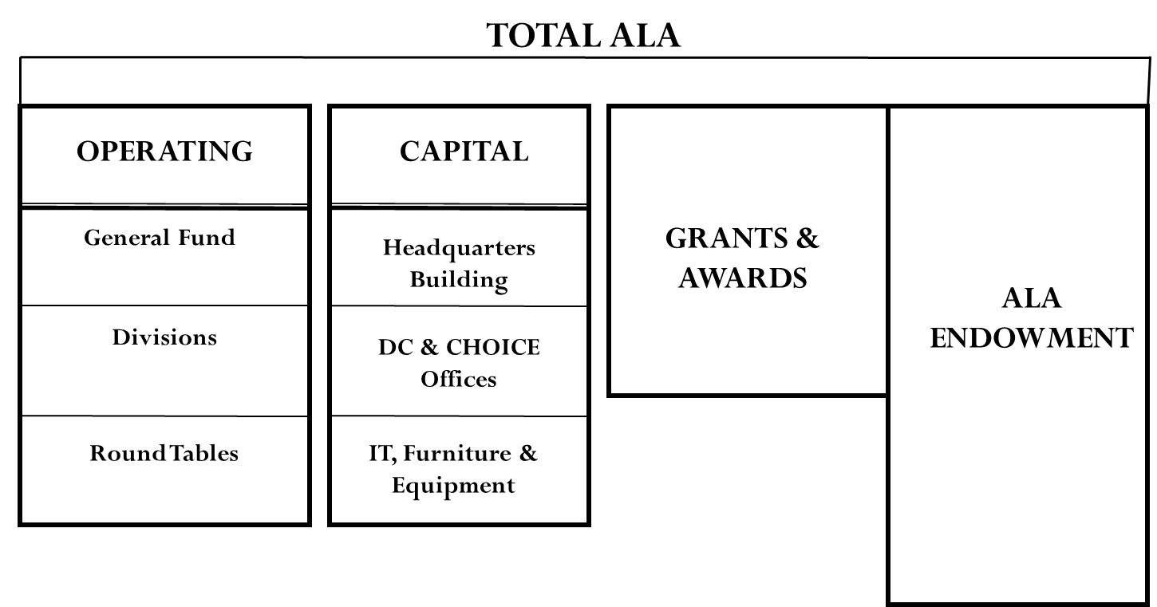
ALA Operating Structure
CAPITAL PROJECTS
Notes:
- Depiction of how we structure our budget, by “funds”
- ALA’s Operating budget is the primary focus of organization and includes general fund, divisions and round tables
- ALA’s Capital budget includes our physical facilities in Chicago, DC and CHOICE offices in CT as well as our IT systems
- ALA’s Grant budget includes mission related grant activities for ALA as a whole as well as the Divisions
- ALA’s Endowment includes a variety of investments but the organization primarily relies on the interest generated by these investments

Slide 6
The ALA Strategic Directions & Five Year Financial Plan
How Do We Achieve the ALA’s Mission and Fund It?
ALA Mission
ALA Key Action Areas
Advocacy for Libraries & the Profession
Diversity
Education & Lifelong Learning
Equitable Access
Intellectual Freedom
Literacy
Organizational Excellence
Transforming Libraries
ALA Five Year Plan
ALA Strategic Directions
Advocacy
Information Policy
Professional & Leadership Development
Equity, Inclusion and Diversity
Core Organizational Values
ALA Annual Budget
Guided by ALA’s Mission and Strategic Directions, the ALA Five Year Financial Plan and Annual Budget act as ALA’s financial “roadmap”
Notes:
Having discussed ALA’s revenue sources and uses, how do we set priorities and ensure alignment with ALA’s mission?
Answer: we start with the mission FIRST, which then informs ALA’s Key Action Areas & Strategic Directions which were defined during ALA’s Strategic Planning Process
Given finite financial resources, how do we evaluate and manage trade-offs when setting strategy and program goals and objectives?
Answer: we consider ALA’s core organizational values as well as the overall long term financial sustainability of the Association
The translation of our mission, goals, and strategy is captured in ALA’s Five Year Financial Plan
The Five Year Plan helps to ensure that the Association is considering longer term investments in the mission as well as financial sustainability
The Five Year Plan then informs the Annual Budget Process

Slide 7
Who are Key Stakeholders in
Development of ALA Budget ?
Broad Overview
- Strategic Plan
- Senior Management
- Planning & Budget Assembly
- Member Leaders
Staff View
- Divisions
- Round Tables
- Committees
- Departments
- Units
Governance View
- Executive Board
- Council
- BARC
- Finance & Audit
Committee
Notes:
When is comes to budgeting, who are the stakeholders? Development of the ALA budget is a very comprehensive and inclusive process. It begins with the “Broad Overview,” which includes the ALA strategic plan used as a guide in the development of the budget
Important to participate in the Planning and Budget Assembly and strategic planning discussions.
Other stakeholders include staff and governance representatives.

Slide 8
Budget Analysis and Review Committee
- BARC -
Charged to review proposed budget as forwarded from Executive Board within the context of the ALA strategic plan and annual priorities.
Reviews current year’s budget financial performance.
Reviews resolutions from Council that may have potential financial implications.
Makes budget recommendations to Executive Board.
Reports to Council on performance of budget.
BARC is a standing committee of ALA Council, consisting of eight members serving non renewable terms:
- six members at large from
general membership
- two members from
Executive Board (staggered 2 year terms)
- ALA Treasurer is a member
Although the Executive Board has the fiduciary responsibility for the budget, BARC has the primary responsibility for detailed review and monitoring of the budget.
Notes:
Review info on slide
Serves as the eyes and ears of the association and its members in all aspects of the budget process.

Slide 9
Council Referrals to BARC
BARC is charged with determining financial impact, if any, of any referrals from Council
BARC works closely with Resolutions Committee to provide a transparent review process for resolutions
BARC reports to Council on findings of financial impact analysis
Recent Council Referrals to BARC
  Services to Immigrants and Refugees
  Fossil Fuel Investments in ALA Endowment
  Roadblocks to Diversity Leaderships
Notes:
Objective analytical view of initiatives in light of other fiscal issues or priorities.

Slide 10
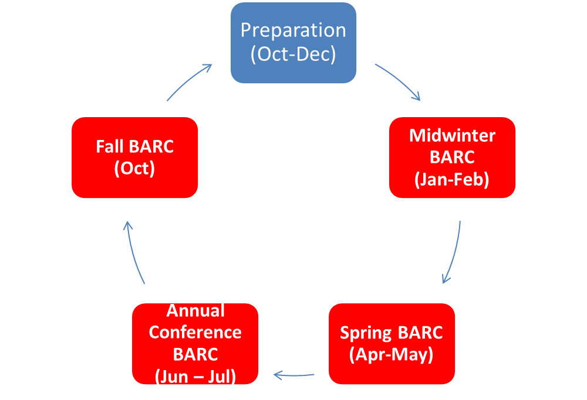
ALA’s Annual Budget Process
How Do We Set Priorities and Allocate Resources Annually?
The ALA Budget Cycle
ALA Staff:
updates Five Year Plan
creates revenue projections
develops budget requests
Key Fiscal Year Assumptions presented to BARC.
PBA guidance and input
Approval by Council
ALA “Final” Budget presented to BARC, F&A, and Board
ALA “Total” Budget presented to BARC, F&A, and Board
Approval by Council
ALA “Preliminary” Budget presented to BARC, F&A, and Board
With the dual goals of mission attainment and financial sustainability, the process for FY19 began in Oct-Dec 2017 (1st Quarter FY18)
Notes:
The diagram on this slide illustrates the steps and timing of ALA’s annual budget process - review steps
Annual budget is developed by each of ALA’s budget managers and presented to BARC, F&A, and the Board for review and approval. Council is asked to take action at Annual and midwinter
ALA’s fiscal year is September 1 – August 31. At any time, we are often dealing with 3 fiscal years. Right now we are in 4th quarter of FY 18, we will begin FY 19 in September and starting planning for FY 20 in fall of 19.

Slide 11
Other Important Information to Know
Final adjustments can and are made to budget between Annual Conference and Fall Executive Board meeting
- final budget is approved at this time (October), even though new fiscal year has started
Once final budget is approved, it is final
New projects/initiatives introduced outside approved budget process will generally have to wait until next budget cycle
- new projects/initiatives developed outside budget process are handled on a case by case basis and encouraged to wait until next budget cycle
Notes:
Although the ALA budget year begins September 1, the final budget is not approved until the fall executive board meeting in October. There isn’t a need for concern as the changes between AC and the fall meeting are generally small and based on year end results. Once the budget is approved at the fall meeting, there are usually no other additions i.e. new initiatives/projects/activities etc., unless the need has to be deemed critical.

Slide 12
The ALA Operating Agreement
Establishes a shared responsibility for the management of the Association
Adopted in 1976 by ALA Council, revised in 1982
Framework for ALA General Fund and Divisions to function together effectively and efficiently
Divisions have the autonomy, independence and freedom to pursue goals and objectives specific to them
Collaboration/Cooperation is our primary priority as ALA and its Divisions have opportunities…to stimulate and build on each other’s strengths

Slide 13
An Important Aspect of the Operating Agreement
Covers mandated central services i.e. Human Resources, Accounting, Building, Office Space, Legal etc.
The rate is calculated annually in Spring/Early Summer via a financial model
The calculation is determined by taking the indirect costs generated by the model for ALA’s revenue generating units - Conferences and Publishing divided by their revenue
The Overhead AKA Indirect Cost Rate
Notes:
Overhead or indirect cost rate is very familiar to revenue producing units, i.e. publishing and conferences, as well as divisions and roundtables. Review slide
It is calculated annually and applied to specific categories of revenue
Funds generated from overhead support association wide functions, i.e. development, HR, IT, that are centralized and provide benefit to all ALA units.

Slide 14
The FY 2017 Indirect Cost Rate – 26.4%
 | Calculated | % of Rate | Effective
Revenue Category | Overhead Rate | Applied | Rate
Dues | 26.4% | NA | NA
Publishing* |  | 50% | 13.2%
Meetings & Conferences |  | 100% | 26.4%
Contributions |  | NA | NA
Miscellaneous |  | NA | NA
*Includes Sale of Materials, Advertising and Subscriptions
Source: Rate application - ALA Operating Agreement page 8
Notes:
This slide shows how the indirect cost rate is applied. 50% of the rate or 13.2% is applied to publishing revenues. 100% of the rate, 26.4% , is applied to conference revenues. No overhead is applied to dues or contributions.

Slide 15
General Fund Net Revenue Sources – 2017
- and other support -
 |  | Overhead | Total
 | Revenues | Support | Support
Interest & Earnings | $ 1,333,533 | $ 0 | $ 1,333,533
Membership Dues - Net | $ 5,363,955 | $ 0 | $ 5,363,955
Publishing - Net | $ 479,990 | $ 2,909,300 | $ 3,389,290
Meetings & Conferences - Net | $ 752,015 | $ 2,482,732 | $ 3,234,747
Other | $ 612,489 | $ 2,080,969* | $ 2,693,458
Total | $ 8,814,982 | $ 7,473,001 | $ 16,014,983
*Overhead contribution from Divisions, Roundtables and Grants
Notes:
Illustration of significance of overhead funds to association revenue
Publishing, meetings and conferences, divisions and roundtables contribute OH that funds critical activities of ALA units
Note that $7.4 million in OH was contributed - $3M from publishing, $2.5M from conferences. $1.6 M was contributed from divisions. - RT $17k both in other category
OH rate in FY 17 was 26.4% . Application of OH rate varies depending on the category of funds.

Slide 16
Eight Month Financial Results Ending 4-30-18
- Total ALA -
Total ALA revenues were $33.2 million compared to budget of $32.9 million
Total ALA expenses were $34.2 million compared to budget of $34.4 million
Net revenue (expense) was $131,155 compared to budget of ($1.7 million)
Total ALA results are tracking well compared to the budget
Notes:
Doing well in FY 18
Result of careful forecasting and managing expenses
Hope to end year with a balanced budget, small amount to the good
Results of annual conference will impact fiscal year outcome

Slide 17
Key Initiatives/Additional Investments in FY 19 Proposed Budget
Enhance fundraising capacity
  Reallocate existing staff positions to support 2.5 additional FTE
  Major gifts director, prospect researcher and support
Support 21st century advocacy efforts
  CRM (customer relations management) system for advocacy information
  Support for enhanced outreach and engagement including “fly-in” event early in budget season for strategic legislative contacts
Strengthen IT infrastructure and services
  First year of three-year planned investment for capacity and customer service
  Improved access to services, communication and information for members, staff and public

Slide 18
FY19 Preliminary Budget Details
(The Numbers Behind Our Plan for FY19)
$46.7M
$28.4M
$3.9M
$13.4M
$.6M
CAPITAL PROJECTS
$TBD
$0.4M
General Fund FY19 Revenue Budget of $28.4M
General Fund FY19 Expense Budget of $30.1M
Budgeted FY19 Net Expense of ($1.7 M)
Support from Net Assets of $1.7 M
General Fund Net Revenue of $0
18
Notes:
Here is the preliminary picture for the FY 19 budget. This budget is subject to revisions based on the FY 18 fourth quarter revenue and expenses and any other critical factors.
The General Fund budget reflects planned strategic investments that will both improve the overall Association’s financial prospects as well as attain mission.
Investment budget of $1.7M in general fund supported by use of net assets.
Grants and awards are projected based on grants in hand as well as grants anticipated.
Division are using $2.2M of their net assets to invest in membership, strategic initiatives, capacity building for new programs and new revenue streams

Slide 19
ALA’s Balance Sheet as of FYE 2017
ASSETS = LIABILITIES + NET ASSETS
ASSETS
“What We Have”
Cash
Accounts Receivable
Inventory
Investments
Land
NET ASSETS
$39.9M
(55% of Assets)
$72.5M
LIABILITIES
“What We Owe”
Accounts Payable
Payroll
Debt
Post-Retirement Benefits
$32.6M
(45% of Assets)
Net Assets is the difference between what we have and what we owe
Notes:
Let’s talk about net assets.This represents ALA’s audited balance sheet at the end of FY 17 or August 2017. It is recalculated at the end of each fiscal year with the annual audit so will be revised in fall 2018.
ALA has a strong balance sheet
The equation for the Statement of Financial Position or Balance Sheet is:
Net Assets = Assets – Liabilities
On left – what we have: $72.5M
Assets = Cash, Investments/Endowment, Real Estate, Inventory etc.
On lower right - what we owe $32.6 M 45%
Liabilities = Payroll, Accounts Payable, Bank Debt, Post retirement Obligation
On upper right – what we have when all liabilities are paid - $39.9 M 55%

Slide 20
A Need to Transition
- Keeping with Policy -
Budgetary Ceiling Components
Unexpended Net Assets for the Divisions and Roundtables
+ Budgeted revenues for the upcoming fiscal year for the
  - General Fund
  - Divisions
  - Roundtables
  - Grants & Awards
  - Long-Term Investments
= Budgetary Ceiling
Annual Estimates of Income Components
Unexpended net assets for total ALA
+ Budgeted revenues for the upcoming fiscal year for the
  - General Fund
  - Divisions
  - Roundtables
  - Grants & Awards
  - Long-Term Investments
= Annual Estimates of Income
Notes:
As we developed the FY 19 budget we realized that the budgetary ceiling approach would not work. In past budgets, the general fund was always balanced, even though that protocol may have limited the capacity of the association to move forward.
Only the division and roundtable net assets were included in the budgetary ceiling calculation. For FY 19 we are also including the General Fund net assets to develop the annual estimate of income. The development of the budgetary ceiling was a practice that has been in place for a number of years but was not defined in any fiscal policy.
Here are specific examples.

Slide 21
ALA Fiscal Year 2019 Budgetary Ceiling
As part of ALA's annual budget process, a budgetary ceiling is calculated and presented to the Budget Analysis and Review Committee (BARC) for approval. The budgetary ceiling document captures and presents all available resources, or sources of funds, that can be expended during the subsequent fiscal year. Sources include a starting amount represented by any accumulated Net Asset Balances, where applicable, built up over previous fiscal years. Additionally, these Net Asset balances are supplemented by budgeted revenues as well as any inter-fund transfers. The total of these sources represents the ceiling, or maximum available resources from all sources. BARC is charged with reviewing and approving the individual fund ceilings and Total All Funds ceiling presented in the bottom row below.
Notes:
For those of you who have been on Council previously you may have seen this presentation of the budgetary ceiling. I know this print is small but the important factor to note is that only the net assets of the divisions and roundtables were represented here. Using the budgetary ceiling protocol, the FY 19 budgetary ceiling is $61.7M. The budgetary is more that the total operating budget – it is the amount beyond which the association cannot incur expenses.

Slide 22
ALA Fiscal Year 2019Annual Estimates of Income
Per Article IX, Finances, Section 1 of ALA's Bylaws: Annual estimates of income shall be based upon the unexpended balance remaining from the previous year plus anticipated revenues for the next budget year. BARC is charged with reviewing and approving the Annual Estimates of Income.
Annual Estimate of Income |  | TOTAL ALA
ALA Net Assets (projected at end of FY 2018) |  | $ 37,643,998
FY 2019 Budgeted Revenues
General Fund |  | 28,353,253
Divisions |  | 13,426,560
Roundtables |  | 398,284
Grants & Awards |  | 3,907,243
Endowment |  | 575,296
TOTAL |  | 46,660,636
FY 2019 Annual Estimates of Income |  | $ 84,304,634
Memo Only
Estimates of Income by Fund
 | Divisions | Round Tables
Available Net Asset Balance (projected at end of FY 2018) | $ 13,263,800 | $ 1,895,316
FY 2019 Budgeted Revenues | 13,426,560 | 398,284
FY 2019 Annual Estimates of Income | $ 26,690,360 | $ 2,293,600
Notes:
The annual estimate of income represents the net assets of the association as a whole and the estimated revenue for FY 19. The annual estimate of income is defined in ALA bylaws as the net assets of the association plus the anticipated revenue for the upcoming fiscal year. The annual estimate for FY 19 is $84.3 M, which is $22.6 M more than the budgetary ceiling.
The annual estimate of income provides a more complete financial picture of the association than the budgetary ceiling. In any case, the annual estimate represents how much money the association could spend. It is far beyond what will be spent in FY 19 based on the revenue estimate of $46.6 M
You will be asked on Monday at Council II to approve the annual estimate of income of $84.3M.

Slide 23
Additional Useful Resources
Member Leaders
  Treasurer
  BARC Chair
ALA Staff
  Executive Director
  Division Executive Directors
  CFO
  ALA Finance Staff
Online Webinars and Other Training
  www.ala.org/aboutala/governance/financialdata
  www.ala.org/aboutala/governance/financialdata/finlearn
  http://www.ala.org/aboutala/sites/ala.org.aboutala/files/content/governance/financialdata/financialrpts/ALA_Financial_Handbook_Final15.pdf
Notes:
Many resources available to you re ALA finances. This presentation is on the Treasurer’s page/

